Slide 1

HSE Quick Checks 2.0
Created for:
Project offer :
P2024053 „Groupwide Re-assessment for HSE maturity – HSE Quick Checks 2.0“
– In following “HSE Quick Checks 2.0” –
Original from 03.04.2024 adjusted on 17.04.2024
Author:
David Faustmann
Managing Director
b.core consulting GmbH

Slide 2
Project offer
Regarding
Consulting Services in the Project "Groupwide Re-assessment for HSE maturity – HSE Quick Checks 2.0"
by
b.core consulting GmbH
Rüttenscheider Str. 74
45130 Essen
– hereinafter referred to as b.core –
to
E.ON SE
Brüsseler Platz 1
45131 Essen
– hereinafter referred to as E.ON –
In accordance with the Request for Proposal P2024053 "Groupwide Re-assessment for HSE maturity – HSE Quick Checks 2.0"

Slide 3
General Information: b.core consulting GmbH
b.core consulting GmbH
Rüttenscheider Straße 74
45130 Essen
Commercial Register: HRB 33872
Register Court: District Court Essen
Represented by:
David Faustmann
Contact
Phone: +49 176 5672 3637
Email: info@bcoreconsult.com
VAT ID
Value Added Tax Identification Number according to § 27 a of the Value Added Tax Act: DE355510790

Slide 4



Our Commitment
We thank you for the opportunity to submit a proposal to E.ON SE for the project "Groupwide Re-assessment for HSE maturity – HSE Quick Checks 2.0." This offer is based on the tender P2024053 "Groupwide Re-assessment for HSE maturity – HSE Quick Checks 2.0," dated March 18, 2024.
E.ON SE is a prioritized partner of b.core consulting GmbH. Therefore, a successful collaboration is of utmost importance to us.
b.core consulting offers, as desired, consultancy and expert support with special knowledge in the field of occupational safety – specifically the HSE Quick Check project – and large-scale program management, and by deploying specifically tailored methods, provides the basis for high-quality program results.
Our involvement can be flexible and swift.
The references & CVs of the consultants offered within the E.ON Group are the foundation for a successful cooperation.
We would be pleased to present our offer in person. For any inquiries, David Faustmann (+49 (0) 176 5672 3637 | faustmann@bcoreconsult.com) is at your disposal.
Essen, April, 17.04.2024
David Faustmann

Slide 5
0
Management Summary
1
Our Understanding of Your Situation
2
Our Solution and Risk Mitigation Approach – Overview
Components of the Solution Approach – Detail
3.1. Phase 1 – Kick-Off and Data Analysis
3.2. Phase 2 – Heat Map Risks
3.3. Phase 3 – Leadership & HSE Capabilities
3.4. Phase 4 – Cultural Maturity
3.5. Reporting and Usability – Consolidation for E.ON HSE Governance
3.6. Summary of Activities & Assumptions
3
4
Our Program Setup – Flexible Proposal
4.1. Program Organization, Team, Team Experience
4.2. Planning
4.3. Commercial Aspects
4.4. CVs
5
References
6
Appendices

Slide 6
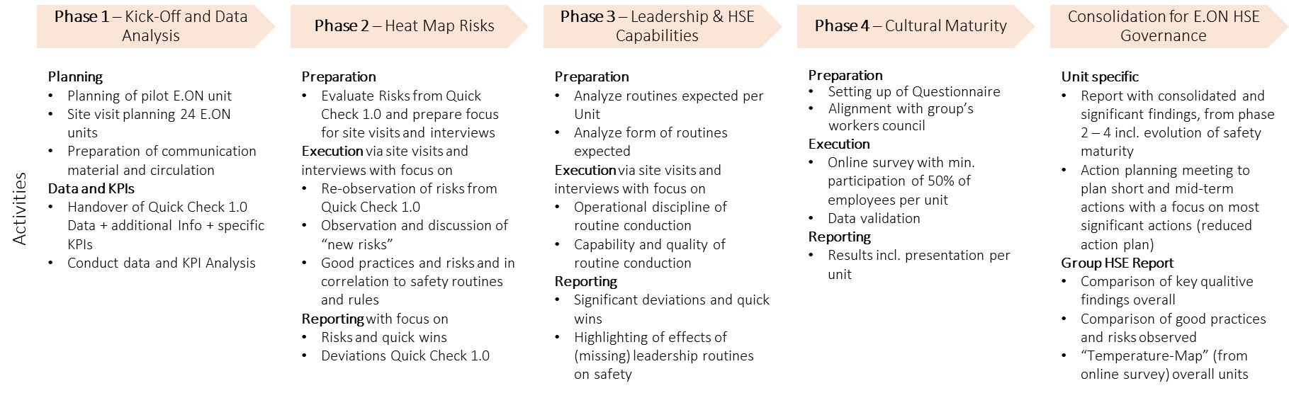
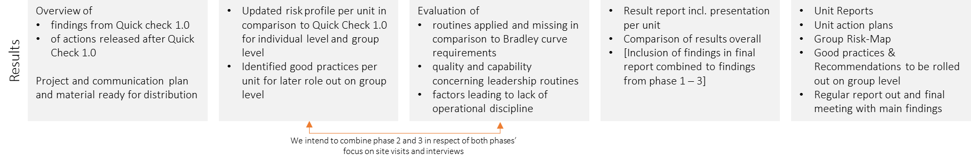
Management Summary of the “Quick Check 2.0”
Setting the goals
Project approach
Tools, Team and Commercials
Determine safety performance, understand evolution since Quick Check 1.0
The Approach follows four phases + the consolidation of core findings on Group HSE level
Use and adaptation of the proven methodology, taking into account the specific situation of E.ON
Situation
Approach
Tools
E.ON continuously improves its safety performance
Safety is a major, if not THE major objective for many E.ON companies and also on headquarter level.
E.ON has historically grown from different companies, possibly resulting in different cultural 'perceptions'
Bradley Curve
13 culture elements
ISO Standard – mainly ISO 45001 – comparison
From historical data to current “Figures”
From Site-Visits to a global Survey to consolidated recommendations
Objective
Results
Commercial
The Quick Check 2.0 is intended to give an evolutionary overview of how E.ON companies have progressed, incl.:
Possible symptomatic patterns when conducting incident evaluations assessing a sample of documentation
Largest existing risks per E.ON unit and E.ON as a whole
Existing and missing safety competencies and leadership routines
Online Survey concerning overall Safety Culture Maturity
Consolidation of insights on Group HSE level
Project duration per Quick Check: 6 weeks
Project start: to be agreed individually with each participating E.ON unit. However, no earlier than Q3 2024
Prize (excl. travel costs) per participating Unit:
Option 1 – EUR 35.055
Option 2 – EUR 30.210
The General Purchasing Conditions of E.ON apply with one topic to be considered:
Reverse Charging will be applied for all E.ON units in countries other than Germany
Documented KPIs, RCAs leadership routines and life-saving rules evaluated
Documented results of the inspections incl. a "heat map" (greatest observed risks) per unit and service provider comparison
Documented cultural maturity
Conducted action planning workshop

Slide 7
FAQ considered upfront the Negotiation & Pitch Presentation Phase (1/2)
No | Questions considered | Answer
1 | Who is b.core consulting? | b.core specifically focusses on businesses’ culture development. A large part of b.core’s assignments aim on solid safety culture initiatives. Culture however is to be understood as the intersection of Management Systems, Routines, Rules and on the other hand the adherence to these to guarantee business success.
2 | Why should E.ON award the project to b.core? | Multiple Reasons David Faustmann has formerly developed the Quick Check 1.0 with E.ON and executed most of these. The methodology is known in every detail. We have approached all consultants of the previous Quick Check 1.0 for the desired countries and closed agreements. This is to ensure an experienced Team with a Quick Check background. For us E.ON is the core client. Our focus after an awarding will be to succeed in the delivery of the desired insights and to grow together with E.ON.
3 | What difference does it make awarding the project to b.core instead of the contractor of Quick Check 1.0? | This question can only be answered by E.ON after all proposals have been handed in. But, according to our competitor analysis and experience from David Faustmann we see the following advantages: We offer the resources that are experienced in the Quick Check 1.0 and in cooperation with E.ON. We have put together a well priced offer focused on efficiency while maintaining the quality.

Slide 8
FAQ considered upfront the Negotiation & Pitch Presentation Phase (2/2)
No | Questions considered | Answer
4 | What difference does it make awarding the project to b.core instead of another competitor? | This question can only be answered by E.ON after all proposals have been handed in. But, according to our competitor analysis we see the following advantages: Concerning the methodology, we expect those competitors to use different methodologies – such as the “safety ladder”. This is reasonable but may lead to a higher “translation” effort on all sides.
5 | Can b.core provide the country specific resources? | Yes. We have frame agreements with resources for all countries required in the RfP. Moreover, to reduce risks of resource availability, in average we have 3 resources available for each country. Agreements (for clarification) incl. tasks and time frame of local execution, daily rates and travel expenses. They conceal E.ON as the requesting Party in alignment to chapter 4.4 of the RfP
6 | Are there any trademarks concerning Bradely Curve and Culture Elements that could hinder the culture assessment? | We have considered this and clarified with the German Patent and Trademark Office (“Deutsches Patent- und Markenamt - DPMA”). To date, there are no registered trademarks concerning the Bradley Curve, the Culture Elements or a Survey in connection to the scope of this project that are hindering the assessment.

Slide 9
0
Management Summary
1
Our Understanding of Your Situation
2
Our Solution and Risk Mitigation Approach – Overview
Components of the Solution Approach – Detail
3.1. Phase 1 – Kick-Off and Data Analysis
3.2. Phase 2 – Heat Map Risks
3.3. Phase 3 – Leadership & HSE Capabilities
3.4. Phase 4 – Cultural Maturity
3.5. Reporting and Usability – Consolidation for E.ON HSE Governance
3.6. Summary of Activities & Assumptions
3
4
Our Program Setup – Flexible Proposal
4.1. Program Organization, Team, Team Experience
4.2. Planning
4.3. Commercial Aspects
4.4. CVs
5
References
6
Appendices

Slide 10
Understanding E.ON’s Situation
Understanding E.ON's HSE Landscape
Aligning with E.ON's Needs
E.ON: A major utility company, driving Europe's energy transition, prioritizing safety and sustainability.
Geographical & Regulatory Diversity: Operations across Europe with varied HSE cultures and legal frameworks.
Continuous HSE Improvement: Commitment to enhancing safety culture and management systems.
Challenges: Aging infrastructure, regulatory pressures, and environmental protection demands increasing HSE complexity.
Occupational Health & Safety: Growing intricacies in workforce safety due to demographic changes and diverse contractor management.
Quick Check Initiative: Assessing and evolving HSE maturity levels, identifying risks, and safety competencies.
Our services address E.ON’s need for robust HSE management and safety culture evolution.
We deliver:
Data analysis for informed decision-making.
Heat map risks to pinpoint safety improvement areas.
Leadership and HSE capabilities to foster a proactive safety environment.
Cultural maturity advancement for long-term HSE success.
Comprehensive reporting, aligned with E.ON's governance standards.
Actionable insights for continuous HSE performance improvement.

Slide 11
0
Management Summary
1
Our Understanding of Your Situation
2
Our Solution and Risk Mitigation Approach – Overview
Components of the Solution Approach – Detail
3.1. Phase 1 – Kick-Off and Data Analysis
3.2. Phase 2 – Heat Map Risks
3.3. Phase 3 – Leadership & HSE Capabilities
3.4. Phase 4 – Cultural Maturity
3.5. Reporting and Usability – Consolidation for E.ON HSE Governance
3.6. Summary of Activities & Assumptions
3
4
Our Program Setup – Flexible Proposal
4.1. Program Organization, Team, Team Experience
4.2. Planning
4.3. Commercial Aspects
4.4. CVs
5
References
6
Appendices

Slide 12
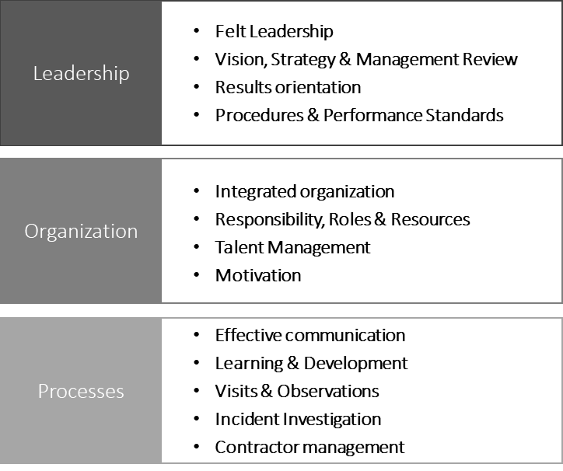
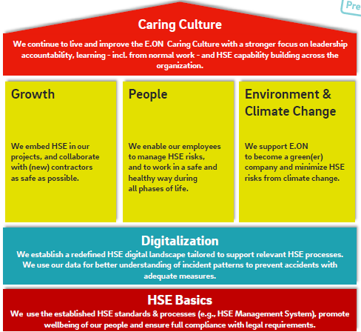
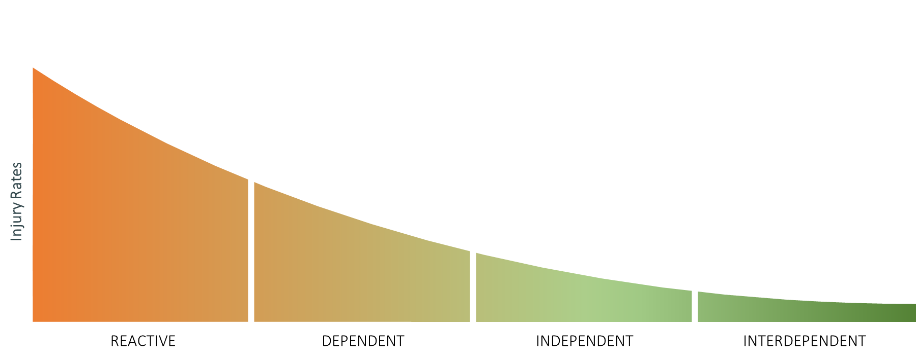
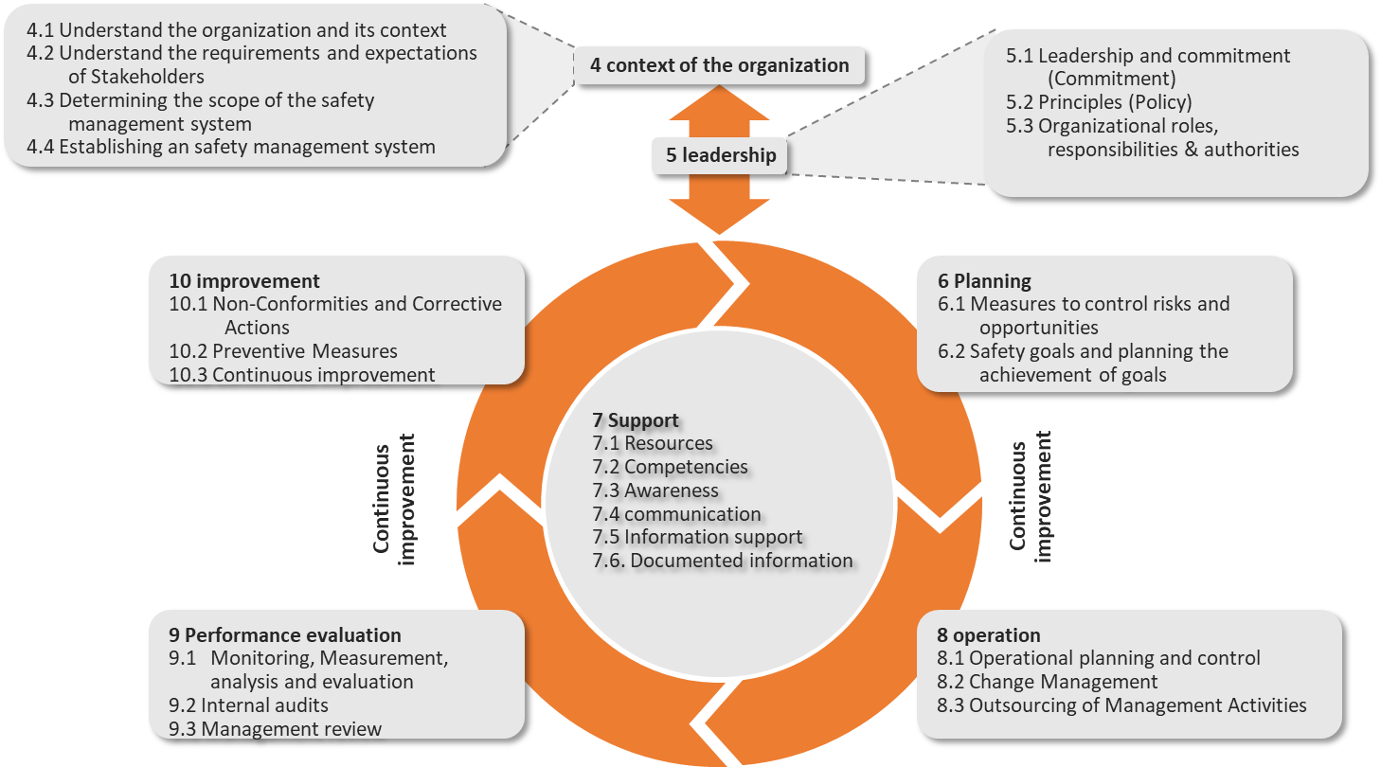
Basic Models used throughout the Quick-Check 2.0
Bradley Curve
13 Culture Elements
ISO Conformity
Caring Culture Relevance
The Bradley Curve identifies four phases or maturity levels of safety culture: reactive, dependent, independent and interdependent (supportive).
The Bradley Curve is determined by the 13 Culture Elements.
The culture elements represent best practice, a practicable assessment Scheme and answer the questions:
How well can the leadership team set the tone and make the necessary decisions?
How efficient is the organization in exploiting knowledge and leveraging potential?
How disciplined is the organization?
Addition:
E.ON has broad Management System experiences. In this context 45001 is considered.
For the sake of practicability, to ease translation we will offer a clear connection between Management System requirements and Culture Element valuation and recommendations. As an example: The Element (marked) “Felt Leadership” can as well be found in the ISO norm chapter 5.1 “Leadership and Commitment”
We do understand the relevance of E.ON’s Caring Culture initiative. According to the current focus, the emphasis lies on the conduction Leadership routines and rule adherence.
This will be respected though out the assessment and fed back in adequate recommendations.
Evolution of the Bradley Curve: By connecting the Bradley Curve, Culture Elements and the ISO standard, recommendations can be given significance based. While the Bradley Curve valuation is typically an average of culture Element valuations, an ISO standard give clear priorization advices leading to reduced complexity during action planning

Slide 13
Our approach follows E.ON phase requirements and allows rapid deduction of recommendation and evaluation of cultural evolution
Phase 1 – Kick-Off and Data Analysis
Phase 2 – Heat Map Risks
Phase 3 – Leadership & HSE Capabilities
Phase 4 – Cultural Maturity
Consolidation for E.ON Group HSE
Planning
Planning of pilot E.ON unit
Site visit planning 24 E.ON units
Preparation of communication material and circulation
Data and KPIs
Handover of Quick Check 1.0 Data + additional Info + specific KPIs
Conduct data and KPI Analysis
Preparation
Evaluate Risks from Quick Check 1.0 and prepare focus for site visits and interviews
Execution via site visits and interviews with focus on
Re-observation of risks from Quick Check 1.0
Observation and discussion of “new risks”
Good practices and risks and in correlation to safety routines and rules
Reporting with focus on
Risks and quick wins
Deviations Quick Check 1.0
Preparation
Analyze routines expected per Unit
Analyze form of routines expected
Execution via site visits and interviews with focus on
Operational discipline of routine conduction
Capability and quality of routine conduction
Reporting
Significant deviations and quick wins
Highlighting of effects of (missing) leadership routines on safety
Preparation
Setting up of Questionnaire
Alignment with group’s workers council
Execution
Online survey with min. participation of 50% of employees per unit
Data validation
Reporting
Results incl. presentation per unit
Unit specific
Report with consolidated and significant findings, from phase 2 – 4 incl. evolution of safety maturity
Action planning meeting to plan short and mid-term actions with a focus on most significant actions (reduced action plan)
Group HSE Report
Comparison of key qualitive findings overall
Comparison of good practices and risks observed
“Temperature-Map” (from online survey) overall units
Activities
Overview of
findings from Quick check 1.0
of actions released after Quick Check 1.0
Project and communication plan and material ready for distribution
Updated risk profile per unit in comparison to Quick Check 1.0 for individual level and group level
Identified good practices per unit for later role out on group level
Evaluation of
routines applied and missing in comparison to Bradley curve requirements
quality and capability concerning leadership routines
factors leading to lack of operational discipline
Result report incl. presentation per unit
Comparison of results overall
[Inclusion of findings in final report combined to findings from phase 1 – 3]
Unit Reports
Unit action plans
Group Risk-Map
Good practices & Recommendations to be rolled out on group level
Regular report out and final meeting with main findings
Results
We intend to combine phase 2 and 3 in respect of both phases’ focus on site visits and interviews

Slide 14
The Work Packages – Advancing E.ON's HSE Excellence: Comprehensive Analysis and Tactical Safety Development
No | Work Packages | Focus Area (Core Aspects)
1 | Data Analysis | In-depth analysis of HSE data and KPIs from Quick Check 1.0 Identification of specific KPIs for targeted improvement strategies
2 | Risk Mapping | Identification and evaluation of risk profiles Best practices and safety routines alignment with safety protocols
3 | Leadership & HSE Capabilities | Analysis of leadership routines and HSE capabilities Emphasis on routine quality and operational discipline
4 | Cultural Maturity | Execution of surveys to gauge safety culture level Presentation of cultural maturity findings
5 | Group HSE Consolidation | Integration of findings into E.ON’s Group HSE reporting Action planning for safety maturity evolution per Unit and symptomatic findings on Group HSE level
ongoing | Constant Project Activities & Result Summary | Communication & Communication meetings Summary of the project's activities and results Recommendations for continuous HSE improvement

Slide 15
Proactive Risk Management: Strategic Actions for Project Assurance (1/2)
No | Risks of the Quick Checks 2.0 | Mitigation Measures
1 | Data Complexity and Integration between Units | The data analytics systematic incl. an analytical scheme will be set up initially to guarantee comparability of results Unexpected results from the analysis will be fed back to the data owner to check validity
2 | Scope Creep | The project scope and stakeholder expectations will be reassured at project kick-off We will conduct regular project and scope review meetings with the E.ON project management
3 | Resource Availability and Expertise | We have gathered skilled consultants/ contractors with local expertise – it was and is our priority to gather local consultants that have experience with the Quick Check 1.0 On local level we have gathered additional backup resources Our implement Quality Assurance protocol dictates initiation meetings prior to each upcoming Quick Check, standby of central staff during the local Quick Check and a redaction of results during analysis of findings Where needed we will arrange continual staff training programs
4 | Contractor Management | We have standardized working procedures across units We will conduct regular contractor evaluations
5 | Communication Barriers | Our resources are fluent in local languages as described in the following chapters (CVs) We will give regular stakeholder updates

Slide 16
Proactive Risk Management: Strategic Actions for Project Assurance (2/2)
No | Risks of the Quick Checks 2.0 | Mitigation Measures
6 | Survey and Data Collection Limitations | We will design robust surveys in collaboration with the E.ON worker's counsel We will incentivize survey participation in collaboration with the central E.ON project management team
7 | Project Coordination and Timing | A detailed project timeline with milestones will be crafted at project initiation. Specifically, the focus is on arranging the order/ sequence of local Quick Checks Contingencies will be planned for delays
8 | HSE Incident Occurrence During Project | Proposal: We should be aware that there is a possibility of incidents happening during the project. As this is critical, E.ON central project management team and we should develop crisis communication plans at project initiation
9 | Stakeholder Engagement | We will initiate early and ongoing engagement activities We will set up feedback mechanisms
10 | General disruptions | David Faustmann will be available throughout the project for fast response In case of unavailability (Sick leave, vacation, etc.) we have assigned the deputy PM, Christopher Spalek

Slide 17
0
Management Summary
1
Our Understanding of Your Situation
2
Our Solution and Risk Mitigation Approach – Overview
Components of the Solution Approach – Detail
3.1. Phase 1 – Kick-Off and Data Analysis
3.2. Phase 2 – Heat Map Risks
3.3. Phase 3 – Leadership & HSE Capabilities
3.4. Phase 4 – Cultural Maturity
3.5. Reporting and Usability – Consolidation for E.ON HSE Governance
3.6. Summary of Activities & Assumptions
3
4
Our Program Setup – Flexible Proposal
4.1. Program Organization, Team, Team Experience
4.2. Planning
4.3. Commercial Aspects
4.4. CVs
5
References
6
Appendices

Slide 18
Detail Overview: Phase 1 – Kick-Off and Data Analysis The Data and KPI Analysis forms the Basis for all further Phases and allows an ad-hoc View on the Effectivity of taken Measures
Challenges
Integrating and analyzing diverse HSE data sets to create a solid foundation for program development.
Validating that current KPIs accurately represent E.ON's safety culture and pinpointing opportunities for safety culture enhancement.
Setting the stage for insightful actions based on a reliable analysis of historical and current HSE data.
2
Deliverables
A detailed report summarizing the analysis of existing data, highlighting key findings and potential areas for safety culture enhancement.
A dashboard of HSE KPIs that will be monitored throughout the project lifecycle.
A project roadmap that outlines subsequent phases based on initial data insights.
Activities
Collect and assess historical HSE data and outcomes from Quick Check 1.0.
Integrate additional relevant information provided by E.ON for a multi-dimensional analysis.
Identify specific KPIs that will inform the current state and target improvements.
Implement a rigorous data validation process to ensure accuracy and relevance.
Utilize standardized analytical scheme to interpret inter-company data sets and uncover patterns or trends that require attention.
1
3

Slide 19
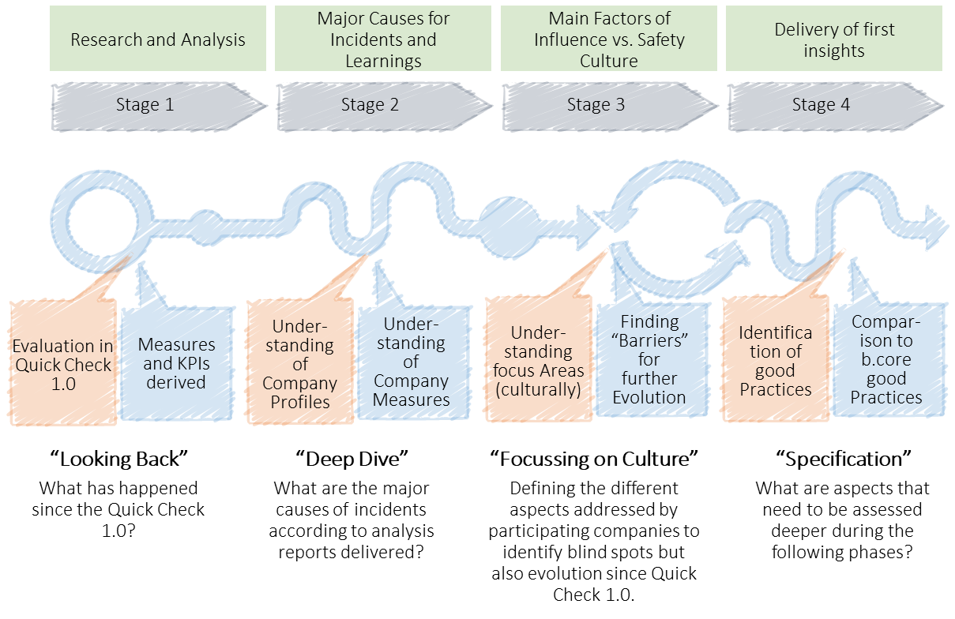
During the Document Analysis Phase, the cultural Evolution can be analyzed based on Data. Moreover, Results support the following Phases
The Document Analysis Approach
The Document Analysis Approach Explained
Initial Findings: Through documentation review, we uncover early insights:
Nature and organizational response to accidents.
Safety report frequency vs. accident occurrence and employee numbers.
Spread of safety information across E.ON networks.
Conclusions: These observations enable us to draw initial conclusions and recognize patterns in safety practices and reporting.
Methodology: Our approach is rooted in harmonized analysis scheme over all unit reports.
Stakeholder Engagement: Collaborative validation of findings with HSE staff and strategic discussions with management ensure alignment and accuracy.
Next Steps: Leveraging initial findings to identify:
Immediate 'quick wins' to enhance safety measures.
Prioritizing locations and topics for subsequent site visits.
Note: This preliminary analysis is crucial for setting actionable priorities and informing the detailed stages of our on-site evaluations.

Slide 20
0
Management Summary
1
Our Understanding of Your Situation
2
Our Solution and Risk Mitigation Approach – Overview
Components of the Solution Approach – Detail
3.1. Phase 1 – Kick-Off and Data Analysis
3.2. Phase 2 – Heat Map Risks
3.3. Phase 3 – Leadership & HSE Capabilities
3.4. Phase 4 – Cultural Maturity
3.5. Reporting and Usability – Consolidation for E.ON HSE Governance
3.6. Summary of Activities & Assumptions
3
4
Our Program Setup – Flexible Proposal
4.1. Program Organization, Team, Team Experience
4.2. Planning
4.3. Commercial Aspects
4.4. CVs
5
References
6
Appendices

Slide 21
Detail Overview: Phase 2 – Heat Map Risks Integrative Risk Mapping: Evolving Safety Insights from Past to Present
Challenges
Ensuring representative coverage of E.ON locations, sectors, and activities during site visits (variety of operational contexts).
Accurately identifying risks by revisiting E.ON units and analyzing current practices against historical data.
Ensuring comprehensive risk evaluation by correlating new findings with past assessments to update risk profiles.
2
Deliverables
A refreshed and detailed risk heat map that includes up-to-date risk data from on-site assessments.
A series of comprehensive risk reports for each unit, combining historical trends with current findings to track safety performance and risk evolution.
Consideration : Utilize the insights from both prior participants of Quick Check 1.0 and new units to ensure an all-encompassing understanding of the group-wide risk landscape.
Activities
Perform on-site visits to all participating E.ON units to assess and update their risk profiles, irrespective of their participation in Quick Check 1.0.
Engage directly with on-site personnel and field managers to collect first-hand information on current safety practices, incidents, and near-misses.
Conduct interviews and discussions to validate previous data and to identify any new or evolving risks.
1
3

Slide 22
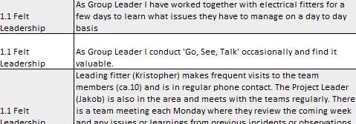
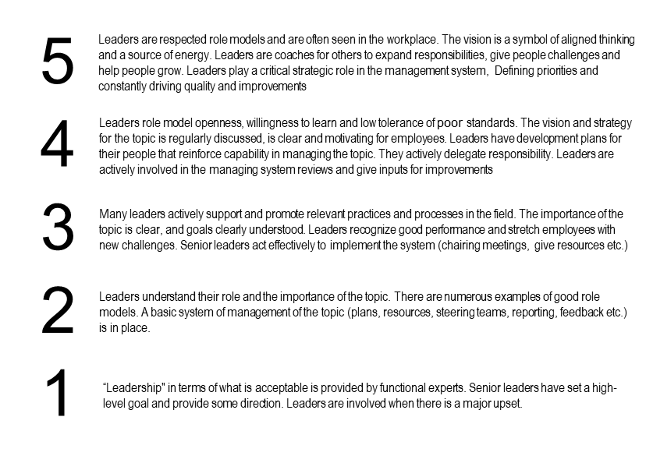
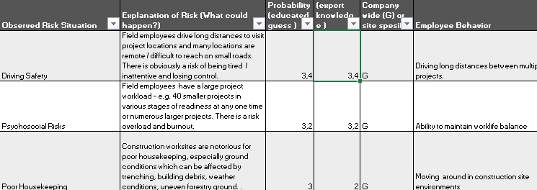

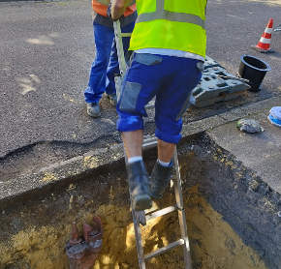
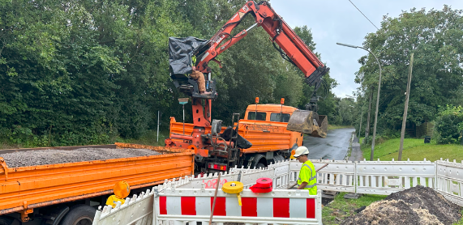
Site-Visits, the Field-Based Safety Assessment: Capturing Real-World HSE Practices
The site-visits: Follow a standardized assessment Scheme draw conclusions concerning Risks & Maturity
The Site-Visit Approach Explained
1
Assessment Scheme – Culture Elements
Standardized Assessment Schemes serve to allocate Observations on Bradely Curve
Site visits are a key component of the Quick Check 2.0, structured to validate and deepen the findings from the risk heat map analysis.
They offer an opportunity to observe and assess the implementation and efficacy of the existing safety management system in action.
The visits aim to provide a nuanced understanding of E.ON’s 'lived' safety culture, uncovering the realities beyond documented procedures and reported data.
Observations will be methodically categorized using the standardized assessment schemes for culture elements and risk mapping.
Findings will contribute to the refinement of the Bradley Curve assessments, enhancing the understanding of safety maturity levels across E.ON units.
Core is:
Observing and assessing on-ground adherence to E.ON's safety protocols.
Evaluating the practical application of the safety management system in day-to-day operations.
Immersing into the 'lived' safety culture to perceive its actual manifestation at various E.ON sites.
2
Assessment Scheme – Risk Mapping
Non-E.ON Observation Examples
Working under suspended loads
PPE - Usage

Slide 23
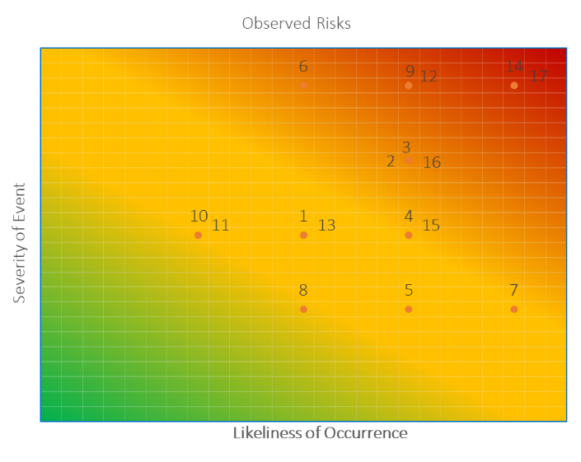
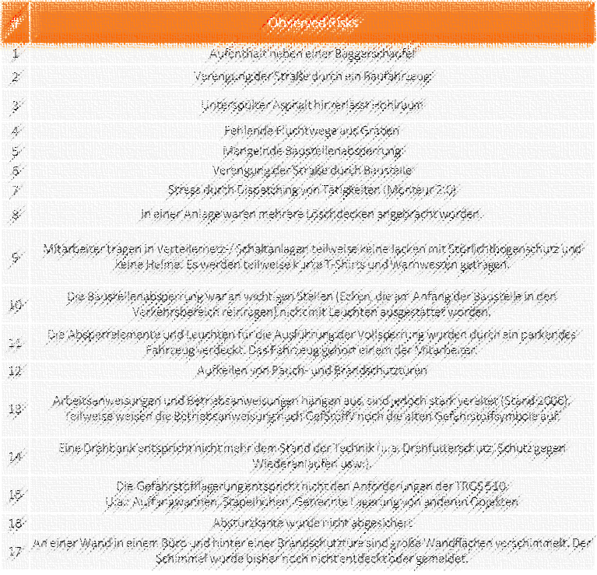
Enhanced Risk Prioritization for E.ON’s Quick Check 2.0
The Risk Analysis Approach
Refining Risk Prioritization Through Heat Map Analysis
Immediate Action necessary
Heat map construction is central to Quick Check 2.0, serving as a management tool for pinpointing and prioritizing risks within E.ON’s diverse operations.
By documenting and evaluating risks, the heat map reflects an up-to-date safety profile of the company, supporting E.ON's commitment to continual safety performance enhancement.
It enables the identification of critical areas for site visits, guiding the Quick Check 2.0 process towards areas that require immediate attention and action planning.
Prioritized risks inform the allocation of safety resources and interventions, fostering a proactive and responsive HSE culture in alignment with strategic objectives.
Monitor closely, act later

Slide 24
0
Management Summary
1
Our Understanding of Your Situation
2
Our Solution and Risk Mitigation Approach – Overview
Components of the Solution Approach – Detail
3.1. Phase 1 – Kick-Off and Data Analysis
3.2. Phase 2 – Heat Map Risks
3.3. Phase 3 – Leadership & HSE Capabilities
3.4. Phase 4 – Cultural Maturity
3.5. Reporting and Usability – Consolidation for E.ON HSE Governance
3.6. Summary of Activities & Assumptions
3
4
Our Program Setup – Flexible Proposal
4.1. Program Organization, Team, Team Experience
4.2. Planning
4.3. Commercial Aspects
4.4. CVs
5
References
6
Appendices

Slide 25
Detail Overview: Phase 3 – Leadership & HSE Capabilities Leadership and HSE-Capabilities: Understanding cultural maturity
Challenges
Thoroughly understanding E.ON’s HSE culture and leadership effectiveness.
Ensuring compliance and management processes align with E.ON's safety standards.
Navigating diverse operational contexts during site visits to accurately assess risks and practices.
Balancing comprehensive assessments with timely, actionable insights.
2
Deliverables
Detailed assessment reports on leadership and HSE capabilities, emphasizing the observed impact on safety culture.
Evaluations of compliance to safety rules, providing a clear view of rule effectiveness and areas for improvement.
Analysis of contractor management effectiveness, with recommendations for enhancing contractor safety alignment.
Consideration : Observations will be structured around the Bradley Curve, providing a maturity framework for E.ON's safety culture. Specific emphasis will be placed on leadership routines, compliance adherence, contractor management.
Activities
Perform targeted site visits with a structured framework to observe and interact with leadership and staff.
Assess the consistency and effectiveness of leadership safety routines in promoting a proactive safety culture.
Evaluate adherence to safety rules and protocols, noting both compliance and instances of non-compliance.
Investigate contractor management strategies to ensure alignment with E.ON’s HSE standards and practices.
1
3

Slide 26
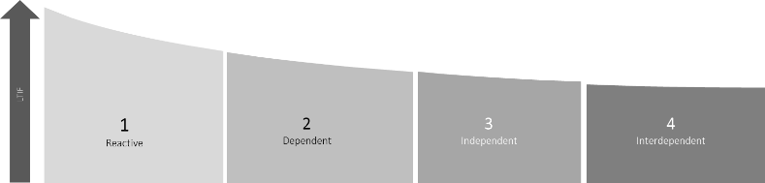
Evaluating HSE Leadership & Culture: Insights from Direct Engagement (1/2)
The site-visits: Focus on Leadership & HSE Capabilities
Comprehensive Leadership & HSE Culture Evaluation
13 Culture Elements are well documented and can be systematically assessed. The expected focus on leadership routines, compliance to rules and contractor management will be respected.
Interactive Site Visits: Perform targeted site visits encompassing both observational assessments and structured interviews with E.ON's leadership and staff.
Leadership Interactions: Conduct interviews to gauge leaders’ perspectives on HSE practices, their influence on safety culture, and the effectiveness of existing leadership routines.
Cultural Immersion: Explore the 'lived' safety culture through dialogue with employees at various levels, understanding the practical embodiment of safety policies.
Compliance and Practices: Assess compliance to safety rules and the integration of these practices in daily operations through direct feedback during interviews.
Contractor Collaboration: Evaluate contractor management through discussions with both E.ON personnel and contractors to ensure a unified approach to safety.
Exemplary Extract of Valuation Criteria
Bradley Curve Maturity accumulates from the 13 Culture Elements – Each of the assessed by a set scheme of requirements

Slide 27
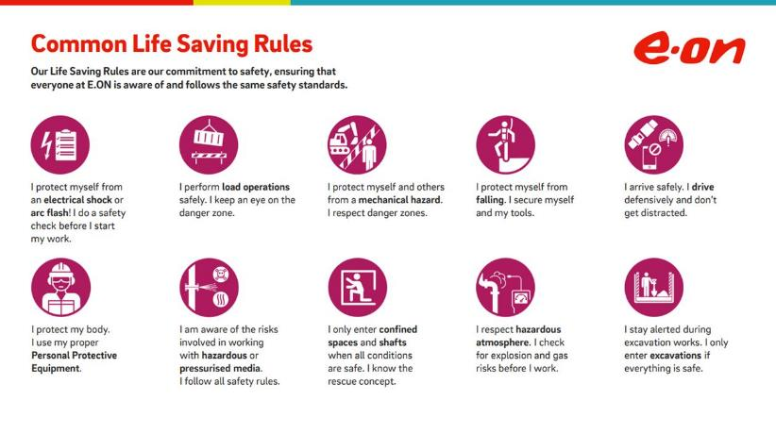
Evaluating HSE Leadership & Culture: Insights from Direct Engagement (2/2)
The Site-Visits: Rule adherence
Capability of setting and enforcing standards and rules
Culture or Cultural Maturity can be defined – in large parts – as adherence to standards. These may be set locally but also on group level. Bradley Curve requirements often refer to this matter when it comes to leadership routine quality rule adherence and also contractor management.
Standards and rules:
Can be set on local and global level
Are an integral part of the cultural maturity
Importance of the observation of standard and rule adherence
It is crucial to observe how “written” rules are carried out in “reality” to understand cultural maturity
It is also important how well the rules depict the “reality” of E.ON’s business for non-relevant rules are often not followed and reduce the relevance of whole rule-sets
Standard and rule setting:
To be effective, standards and rules must be in line with HSE objective and Risks (upwards) and also…
… must be part of routines carried out by the leadership (for example be a part of safety walks by leadership personnel)
Note: E.ON has a comprehensive set of rules on different levels. Special focus will be set on this component during site-visits and interviews.
LinkedIn Screenshot

Slide 28
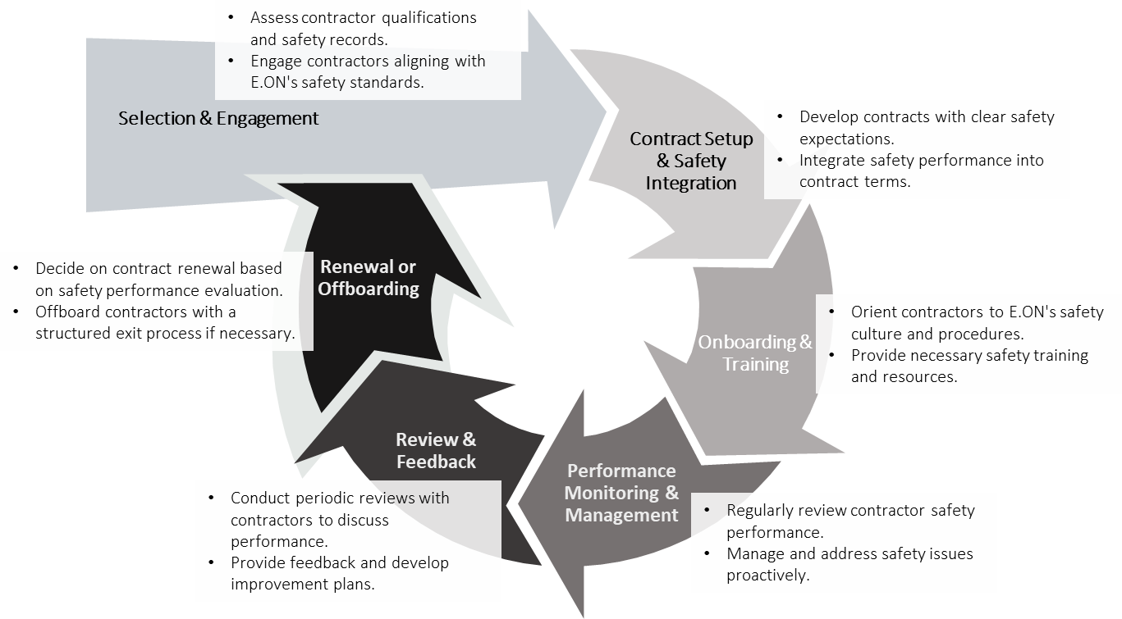
Focusing on Contractor Management during Site Visits and Interviews
The Site-Visits & Interviews: Contractor Management Methodology
Contractor Management and it’s Importance for E.ON companies
Contractor management follows a process which involves different roles and both operative management but also contractual management
Relevance of Contractor Management in General:
Contractor Management is not equally relevant for all E.ON companies. Depending on the ratio of contractors to own operative staff it differs
Thus, the evaluation of the “Culture Element – Contractor Management” will have different relevance for different E.ON companies. This independent of the overall cultural rating
Relevance of different Stages of the Contractor Management Cycle
As different roles are involved, different stages may be of relevance
From experience the valuation and contract setup stage is well developed
We expect deviations in the onboarding & training but also in the review and renewal stage
Our focus:
Site-visits will help observing the adherence of contractors to set standards. This opens the room for discussion on how contractors can be trained better, monitored closer or may have to cope with consequences (by E.ON)
Interviews will help to narrow down the topic to generate more specific recommendations

Slide 29
0
Management Summary
1
Our Understanding of Your Situation
2
Our Solution and Risk Mitigation Approach – Overview
Components of the Solution Approach – Detail
3.1. Phase 1 – Kick-Off and Data Analysis
3.2. Phase 2 – Heat Map Risks
3.3. Phase 3 – Leadership & HSE Capabilities
3.4. Phase 4 – Cultural Maturity
3.5. Reporting and Usability – Consolidation for E.ON HSE Governance
3.6. Summary of Activities & Assumptions
3
4
Our Program Setup – Flexible Proposal
4.1. Program Organization, Team, Team Experience
4.2. Planning
4.3. Commercial Aspects
4.4. CVs
5
References
6
Appendices

Slide 30
Detail Overview: Phase 4 – Cultural Maturity The Online Survey
Challenges
Crafting a survey that accurately captures the nuances of E.ON’s safety culture together with E.ON worker’s counsel
Engaging employees at all organizational levels to ensure a comprehensive view.
Interpreting survey data to form a detailed cultural maturity profile for actionable insights.
2
Deliverables
Cultural Maturity Reports detailing the current state of safety culture within E.ON companies and E.ON Group, with an analysis of survey results.
Recommendations for targeted interventions to foster an enhanced safety culture, with a focus on employee engagement and leadership commitment.
Survey Report per unit, outlining
Progress on Bradley Curve towards employee engagement increase and E.ON’s Caring Culture aspects
Differences between surveyees on different organizational levels
Activities
Develop and validate comprehensive questionnaires in alignment with E.ON's safety culture framework.
Execute a company-wide online survey to gauge employees' perceptions of safety practices and culture.
Synthesize survey data to create a detailed cultural maturity profile for each E.ON unit.
Review the cultural maturity findings against the Bradley Curve to identify stages of cultural development and areas for improvement.
1
3

Slide 31

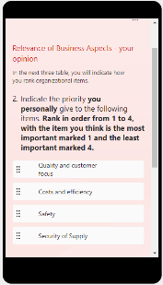
The Online Survey: Uncovering the Layers of Safety Culture
Cultural Maturity – Online Survey and Data Compilation
The Online Survey explained
The Online Survey is a powerful tool for assessing and catalyzing safety culture improvement during any phase of E.ON companies’ journeys towards stage 4 in the barley Curve. We will work with you to prepare the survey, analyze the results and develop an implementation plan to revitalize your existing safety program across all levels of your organization.
Data collection - Inclusion of all employees on all levels to gain a wholistic view:
~20 questions (20 minutes) to measure employee safety awareness
On-line and prepared in the native languages of the participating E.ON companies
3 categories: Leadership, Organization, Processes and Actions
Benchmark within the participating group of E.ON companies and against Bradley Requirements
Data compilation – Unit specific consolidation of results:
Results will be evaluated along the same scheme of the Bradley Curve Culture Elements as is used during the Site Visits and Interviews
Survey results allow a differentiation between different levels and across all benchmark participants
Remark: The Online Survey is an excellent tool to verify On-Site-Visit results and help us understand backgrounds of behavior and mindsets. It should specifically reflect different perspectives on rule and standard adherence as well as the effectiveness of leadership routines
The Online Survey will be prepared in collaboration with E.ON’s workers’ counsel.

Slide 32
0
Management Summary
1
Our Understanding of Your Situation
2
Our Solution and Risk Mitigation Approach – Overview
Components of the Solution Approach – Detail
3.1. Phase 1 – Kick-Off and Data Analysis
3.2. Phase 2 – Heat Map Risks
3.3. Phase 3 – Leadership & HSE Capabilities
3.4. Phase 4 – Cultural Maturity
3.5. Reporting and Usability – Consolidation for E.ON HSE Governance
3.6. Summary of Activities & Assumptions
3
4
Our Program Setup – Flexible Proposal
4.1. Program Organization, Team, Team Experience
4.2. Planning
4.3. Commercial Aspects
4.4. CVs
5
References
6
Appendices

Slide 33
Detail Overview: Reporting and Usability Unit specific Reporting, the Action Planning Workshop and the Consolidation of Insights on Group HSE Level
Challenges
Integrating diverse HSE data to form a coherent, actionable picture for strategic decision-making.
Tailoring action plans to each E.ON company's unique context within the group strategy.
Visualizing risk comprehensively to track progress and inform global strategies.
Ensuring the continuity between Quick-Check 1.0 & 2.0
2
Deliverables
A unit-specific report for each E.ON company, including a comprehensive view of all project phases and their interconnections. Subsequently, an action planning workshop to activate recommendations in a clear roadmap.
An E.ON Group Heat Map visualizing greatest risks and benchmarks for progress.
A consolidated E.ON Group Report, which includes:
Compilation of risk categories and good practices.
Comparative analysis of the Bradley Curve allocation, detailing core drivers and insights for global program development.
Summary of overarching data analysis findings to inform Group-level strategies.
Activities
Integrate findings from data analysis, risk mapping, site visits, leadership interviews, and survey results into a coherent report structure.
Conducting an action planning workshop per unit
Highlight key risk areas and categorize them for prioritization.
Identify and document good practices for potential rollout across the E.ON Group.
Analyze the cultural maturity level of each unit using the Bradley Curve, emphasizing main drivers for development.
1
3

Slide 34
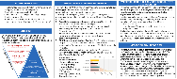
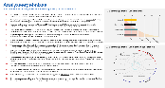
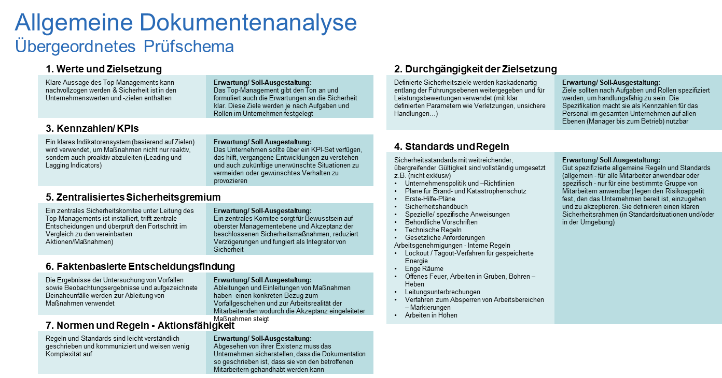
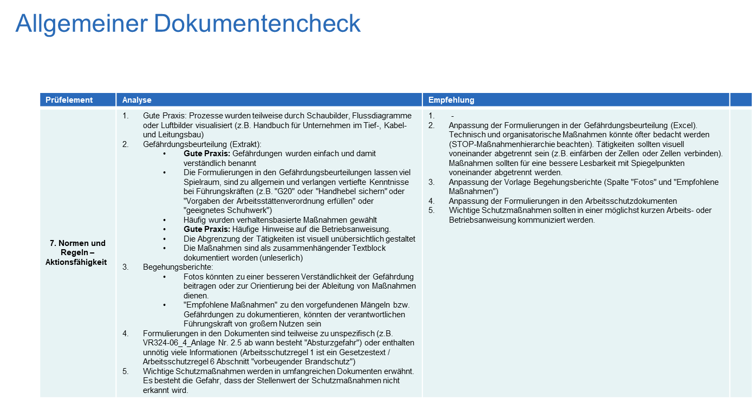
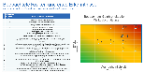

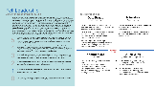

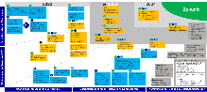
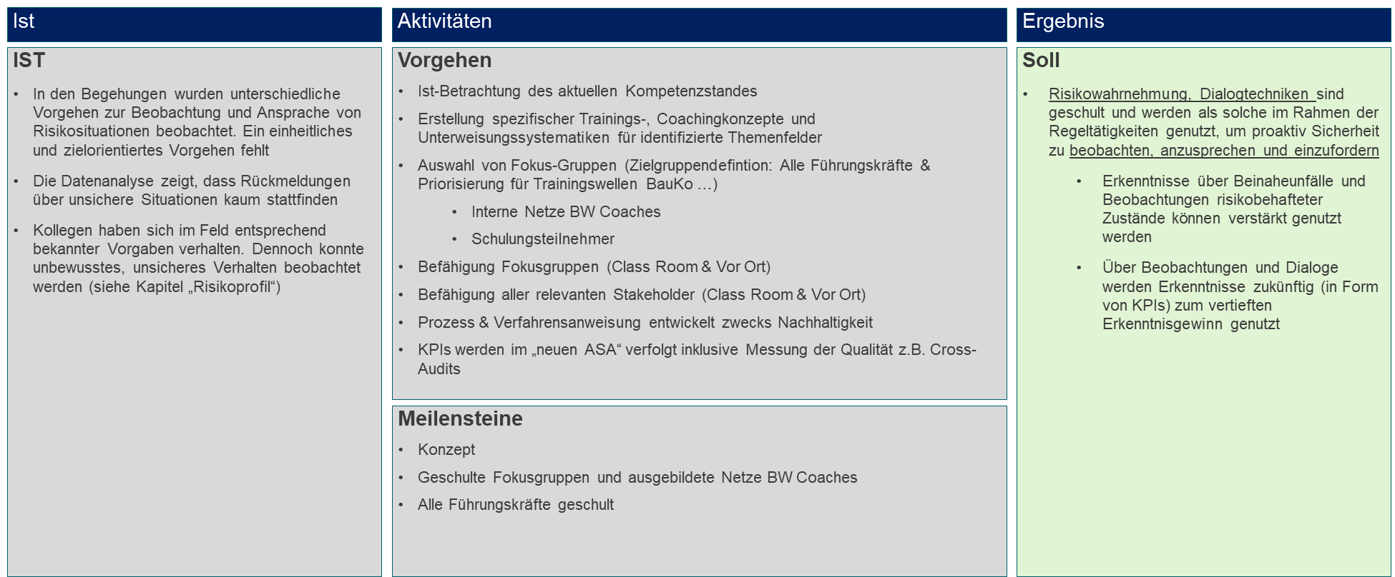
The unit-specific report and Action Planning workshop: A Multi-Dimensional View for Each E.ON Entity
Unit Report and Action Planning Workshop – Content, Structure and Examples (Project examples used below for display purposes)
Unit Report and Action Planning Workshop explained
Management Summary
All insights are gathered and interconnected to display the “big picture”
Data and KPI
Incident reports and KPIs are analyzed in depth to understand methodical and cultural evolution as a basis for further project phases
Unit Report:
Management Summary: A synthesis of all critical findings, offering a strategic overview that links data analysis to actionable insights.
Data and KPI Analysis: Deep dive into safety incidents, near misses, and compliance rates, cross-referenced with KPIs to track progress and pinpoint focus areas.
Risk Mapping Overview: Summarizes key risks, their potential impact, and frequency, along with a prioritization matrix to guide immediate actions.
Cultural Evaluation Breakdown: Detailed account of the cultural strengths and improvement areas as aligned with the 13 culture elements, spotlighting specific units' cultural maturity.
Action Planning Workshop
Road Mapping Activities Consolidation: Interactive session focusing on transforming high-value measures into practical steps, setting a roadmap for immediate and long-term HSE enhancements.
Project Kick-Off Material Preparation: Crafting the materials that set the stage for project implementation, aligning team expectations and project milestones.
Targeted Action Identification: Collaborative development of targeted actions based on the report's findings, designed to elevate the safety culture maturity.
Development Plans: Outlines the specific recommendations for each unit based on the cultural maturity profile and risk assessment.
Unit Report
Risk Mapping
Observations concerning high risk situations and/ or conditions and good practices are documented to display urgencies but also identify patterns per Unit
Culture Evaluation
Each Unit is evaluated by 13 culture elements (strict evaluation scheme) with specific recommendations according to discovered development needs
Consolidation of Evolution Road Mapping Activities
High value measures are broken down to be discussed during a Road Mapping Workshop
Preparation of Project Kick-Off Material
During a Action Planning Workshop, main activities and objectives will be defined to be conducted for further evolution of the cultural maturity
Action Planning Workshop

Slide 35
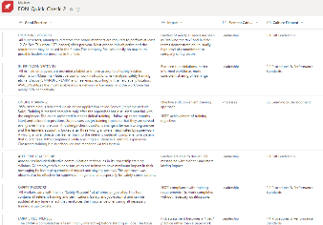
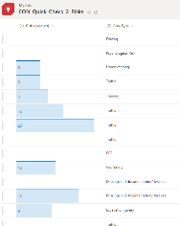

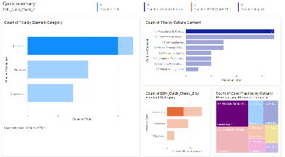
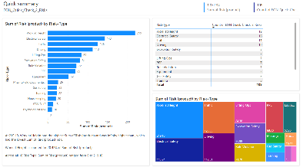
Consolidation: Group-Wide HSE Insights and Actions
Consolidated Reporting – Content, Structure and Examples (Examples below created for display purposes)
Consolidation explained
Good Practice Collection
All Good Practices and their impact are collected to present solutions to other E.ON units
Risk Collection
All Risks are collected and categorized from the separate Unit reports incl. risk valuation
The consolidation process ensures a standardized approach to capturing and utilizing safety data for continuous improvement. It facilitates the transfer of knowledge and successful practices between units, fostering a cohesive and proactive safety culture across the Group.
Collection:
Good Practice Repository: A compendium of effective safety practices, innovations, and initiatives identified across various E.ON units, ready for peer learning and adaptation.
Risk Aggregation: A compiled risk registry that categorizes and prioritizes risks identified from individual unit reports, facilitating strategic group-level risk management decisions.
Usability for E.ON Group HSE
Strategic Insight: Enables the E.ON Group HSE to gain a panoramic view of safety performance and strategic initiatives.
Best Practices: Supports the establishment of benchmarks and dissemination of best practices for uniform safety standards across all units.
Decision Support: Assists in data-driven decision-making by providing a holistic view of risks and opportunities, underpinning the Group's safety governance framework.
Reporting in a structured and actionable Way
An ongoing report out will be presented to E.ON Group HSE. Key aspects are to share Good Practices to be rolled out across all units but also highest Risks throughout E.ON to decided on global actions.

Slide 36
0
Management Summary
1
Our Understanding of Your Situation
2
Our Solution and Risk Mitigation Approach – Overview
Components of the Solution Approach – Detail
3.1. Phase 1 – Kick-Off and Data Analysis
3.2. Phase 2 – Heat Map Risks
3.3. Phase 3 – Leadership & HSE Capabilities
3.4. Phase 4 – Cultural Maturity
3.5. Reporting and Usability – Consolidation for E.ON HSE Governance
3.6. Summary of Activities & Assumptions
3
4
Our Program Setup – Flexible Proposal
4.1. Program Organization, Team, Team Experience
4.2. Planning
4.3. Commercial Aspects
4.4. CVs
5
References
6
Appendices

Slide 37
Summary of activities per phase
No | Project Phase | Activities | E.ON Responsibilities
1 | Kick-Off and Data Analysis | Preparation of Unit-specific project conduction incl. document review, site visits, validation and action planning workshop Preparation of communication material for all E.ON units and conduction of kick-off meeting per Unit Collect HSE data and Quick Check 1.0 outcomes Analyze sample (~3) incident reports and KPI effectiveness Review representative RCAs (~3) A sample of documented data will be analyzed Further documentation will be analyzed per unit (e.g. “HSE-Handbook”) – a list of needed documentation will be provided | E.ON unit project management plans site visits, action planning workshop and participation of leader and staff in alignment with local resources E.ON Group PM and unit PM support the circulation of communication material E.ON representatives are available for kick-off meeting E.ON provides all major incident reports since Quick Check 1.0 Access to all current Safety KPIs and related data Provision of approximately 3 representative RCAs for in-depth analysis
2 | Heat Map Risks | Conduct site visits to identify risks Update risk profiles based on findings | Entry to diverse locations ensured by E.ON Representative sample of E.ON sites covered
3 | Leadership & HSE Capabilities | Site visits and leadership interaction Conduct interviews and discussions Evaluate safety rules compliance and contractor management | Leadership availability for discussions and interviews around site visits Operative sites for visits to interact with staff and contractors
4 | Cultural Maturity | Deploy online survey on safety culture Transparent reporting of survey findings | Minimum 50% survey participation across units
5 | Reporting and Usability | Compile and deliver unit-specific and consolidated E.ON Group HSE reports Facilitate workshops for action planning on local level | Timely access to all necessary data and personnel Regular updates and feedback loops with E.ON

Slide 38
Site-Visits – Assumptions concerning Site-Visits
 | Focus | Explanation
1 | Divisions | The relevant divisions of E.ON are visited. Power Gas Heat Water Customer solutions It is important to note that not all E.ON units operate across all media/ business areas. During the Quick Check 2.0 this will be considered during the planning.
2 | Type of locations visited & activities to be observed | Site visits are conducted in the context of recurring and significant activities to ensure greatest benefit/significant outcomes Maintenance activities Operational activities Construction activities
3 | Quantity | As Phase 2 and 3 both are mainly driven by site-visits, E.ON has requested 8 site-visits for Phase 2 and 8 site-visits for phase 3. Both include interviews and discussions with field staff and leaders. This is depicted in option 1 below. We propose an effort reduction in option 2. Risk mapping and the observation of routines and rule adherence go hand in hand during a site-visit. Thus, both phases can be supported in parallel. We will depict the options in the price and effort calculation for E.ON to chose the suitable approach Option 1: 16 site visits equally distributed across the divisions within the considered E.ON Units Option 2: 8 site visits equally distributed across the divisions within the considered E.ON Units + 1 day remote to clarify additional question and/ or for leadership interviews to be conducted

Slide 39
Scope of Service
The services explicitly described in the offer are the only ones included. Notably, the offer does not cover:
Any form of legal advice
Tax consultation
Economic auditing
Granting licenses or usage rights to software products and tools used by b.core
Specific Exclusions
All written work/documentation will be provided in English. No other languages are planned for these documents.
Site visits and interviews with field staff and leaders will be conducted in the local language.
The Action Planning Workshop will also be conducted in the local language.
b.core is open to offering additional services not included in the current offer.

Slide 40
Service Modification Clause
b.core may undertake minor changes to the contracted services without the prior approval of E.ON, provided these changes align with E.ON's actual or assumed intentions, and E.ON's approval cannot be obtained in time, or if not obtaining approval would otherwise disadvantage E.ON. b.core will inform E.ON of any such changes and their impact on the program.
For changes that are not minor, especially those affecting the scope of services to be provided, a formal agreement via a Change Request process between the contracting parties will be necessary.

Slide 41
Collaboration Obligations of E.ON (1/2)
Fundamental for successful programs is extensive collaboration with the client. b.core therefore assumes that E.ON will be intensively involved in all program phases. In addition to the timely completion of tasks defined in the program planning, E.ON is obliged to perform specific actions to assist in service delivery, especially regarding:
Involvement in necessary cooperation and provision of information
Active engagement of E.ON decision-makers to make operational decisions for program success
Availability of a program sponsor from E.ON to promote and support the program
Willingness to adapt among participants and stakeholders
Continuous collaboration with necessary resources from E.ON as specified in program organization and the availability of contacts from the subject departments
Timely provision of all information, documents, and data required for service delivery

Slide 42
Collaboration Obligations of E.ON (2/2)
b) Collaboration activities related to infrastructure:
Provision of a documentation and communication system, such as MS Office.
Provision of work and meeting spaces with the necessary equipment, complying with relevant accident prevention regulations.
Provision of suitable communication tools (telephone, WLAN/LAN, etc.) and office materials (such as photocopiers) for the consultants, and as needed for their own program organization.
b.core consultants will be equipped with laptops including operating system and supporting application software (such as MS Office products). Further necessary hardware and software for program execution, including an adequate number of workstation screens, will be provided by E.ON.
Take over the organization and costs for travel, accommodation, and meals for program staff and workshop participants.
c) Provision of the required qualified resources as planned:
b.core will report to E.ON's decision-makers any issues with program collaboration. Collaboration services by E.ON are provided free of charge.
If E.ON's collaboration actions are omitted:
If E.ON fails to provide the described collaboration actions, insufficiently or belatedly, resulting in delays in the program, the deadlines will be extended or shifted as indicated in the program plan accordingly. Any additional effort due to unprovided collaboration services will have to be compensated by E.ON according to the fees regulated in the " Commercial Aspects" chapter.

Slide 43
0
Management Summary
1
Our Understanding of Your Situation
2
Our Solution and Risk Mitigation Approach – Overview
Components of the Solution Approach – Detail
3.1. Phase 1 – Kick-Off and Data Analysis
3.2. Phase 2 – Heat Map Risks
3.3. Phase 3 – Leadership & HSE Capabilities
3.4. Phase 4 – Cultural Maturity
3.5. Reporting and Usability – Consolidation for E.ON HSE Governance
3.6. Summary of Activities & Assumptions
3
4
Our Program Setup – Flexible Proposal
4.1. Program Organization, Team, Team Experience
4.2. Planning
4.3. Commercial Aspects
4.4. CVs
5
References
6
Appendices

Slide 44
Program Organization
Program E.ON Quick Check 2.0
Project Responsibility
Control: The Project is centrally controlled
Multiple Barriers are introduced to guarantee steadily high quality
Standards concerning assessments but also data analysis are either set centrally or the assessment are conducted centrally (as far as possible)
Result-oriented involvement: E.ON Responsible and PM is/ are steadily involved in a most efficient way possible (result-driven)
Effectivity-oriented involvement: However, the organization allows fast responses on errors, quality hazards but also communication issues
Localization where needed: local b.core consultants guarantee barrier free communication while following a centrally given approach
E.ON
Mr. Finn Petersen
Ms. Melanie Donisch
b.core
David Faustmann
PMO and Change Mgmt.
Project Management
E.ON
Ms. Melanie Donisch
b.core
Tim Möller
E.ON
Mr. Finn Petersen
Ms. Melanie Donisch
b.core
David Faustmann
xxx
Quality Mgmt.
Team – “Data”
Team – “Local Execution”
Team – “Survey”
E.ON
Ms. Melanie Donisch
xxx
NN (Expert xx)
b.core
Tim Möller
David Faustmann
Local E.ON PM/ Safety Expert
Local b.core consultant
E.ON Worker’s Counsel
Ms. Melanie Donisch
Tim Möller
David Faustmann
Data Governance
Data Harmonization
Data Consolidation
Document analysis
Site-Visits and Interviews
Action Planning WS
Preparation and Alignment
Conduction
Report Creation

Slide 45
Skill-Set, Experience and Education of the Team
The skill set, experience, and education of the proposed team have been matched to the requirements of the project. Following this section, you will find CVs and references.
Considered Elements | Anforderungen an das Team Setup | Project Responsible / PM: David Faustmann | Deputy PM: Christopher Spalek | Experts
Skill-Set | Strategic/conceptual skills, underpinned by many years of HSE consulting experience | PPP | PPP | PPP
 | Service orientation (proactive recognition and pragmatic implementation of potential improvements or solutions) | PPP | PPP | PPP
 | Routine handling and experience with high-level stakeholders from corporate management and executive boards | PPP | PPP | PPP
 | Experience in cooperation with operationally active employees such as site leadership and fitters/ fieldworkers and contractors | PPP | PPP | PPP
Experience | Experience with HSE culture change, culture development, and the respective challenges in large companies/ conglomerates | PPP | PPP | PPP
 | Experience in HSE culture improvement based on the Bradley Curve and HSE cultural elements and/ or ISO 45001 requirements | PPP | PPP | PPP
 | Knowledge of E.ON and E.ON companies (especially processes, structures, etc.) and the cultural HSE background | PPP | PP | PP
 | Knowledge of and former participation in overarching HSE initiatives within the E.ON Group such as Quick Check 1.0 or the Caring Culture Initiative | PPP | PPP | PP
 | Experience in the implementation of HSE measures/advisory services | PPP | PPP | PPP
 | Many years of experience in the management of (HSE) major projects | PPP | PPP | PP
Education | Master’s/ Bachelor’s degree or doctorate in economic and/or technical studies | PPP | PPP | PPP
 | At least 10 years of relevant professional experience (e.g., in corporate consulting/ HSE Consulting/ etc.) | PPP | PPP | PPP
 | Proven skills in process management, data handling and in the digitalization of processes | PPP | PP
 | Skills in delivering Site-Visits and Action Planning Workshops in local language and report preparation in English | PPP | PPP | PPP
 | HSE-specific training (e.g., safety specialist, safety engineer*, safety officer, etc.) | P | PPP | PPP
Key:
Fully meets requirements: Can be confirmed by internal resources of E.ON/ E.ON companies | In terms of 'Education': Certificate can be presented
Meets requirements: Potential confirmation by third-party corporate resources | Regarding 'Education': Equivalent training including certificate.
Partially meets: Proven to be approximately fulfilled | Regarding 'Education': Self-taught without a certificate.
PPP
PP
P

Slide 46


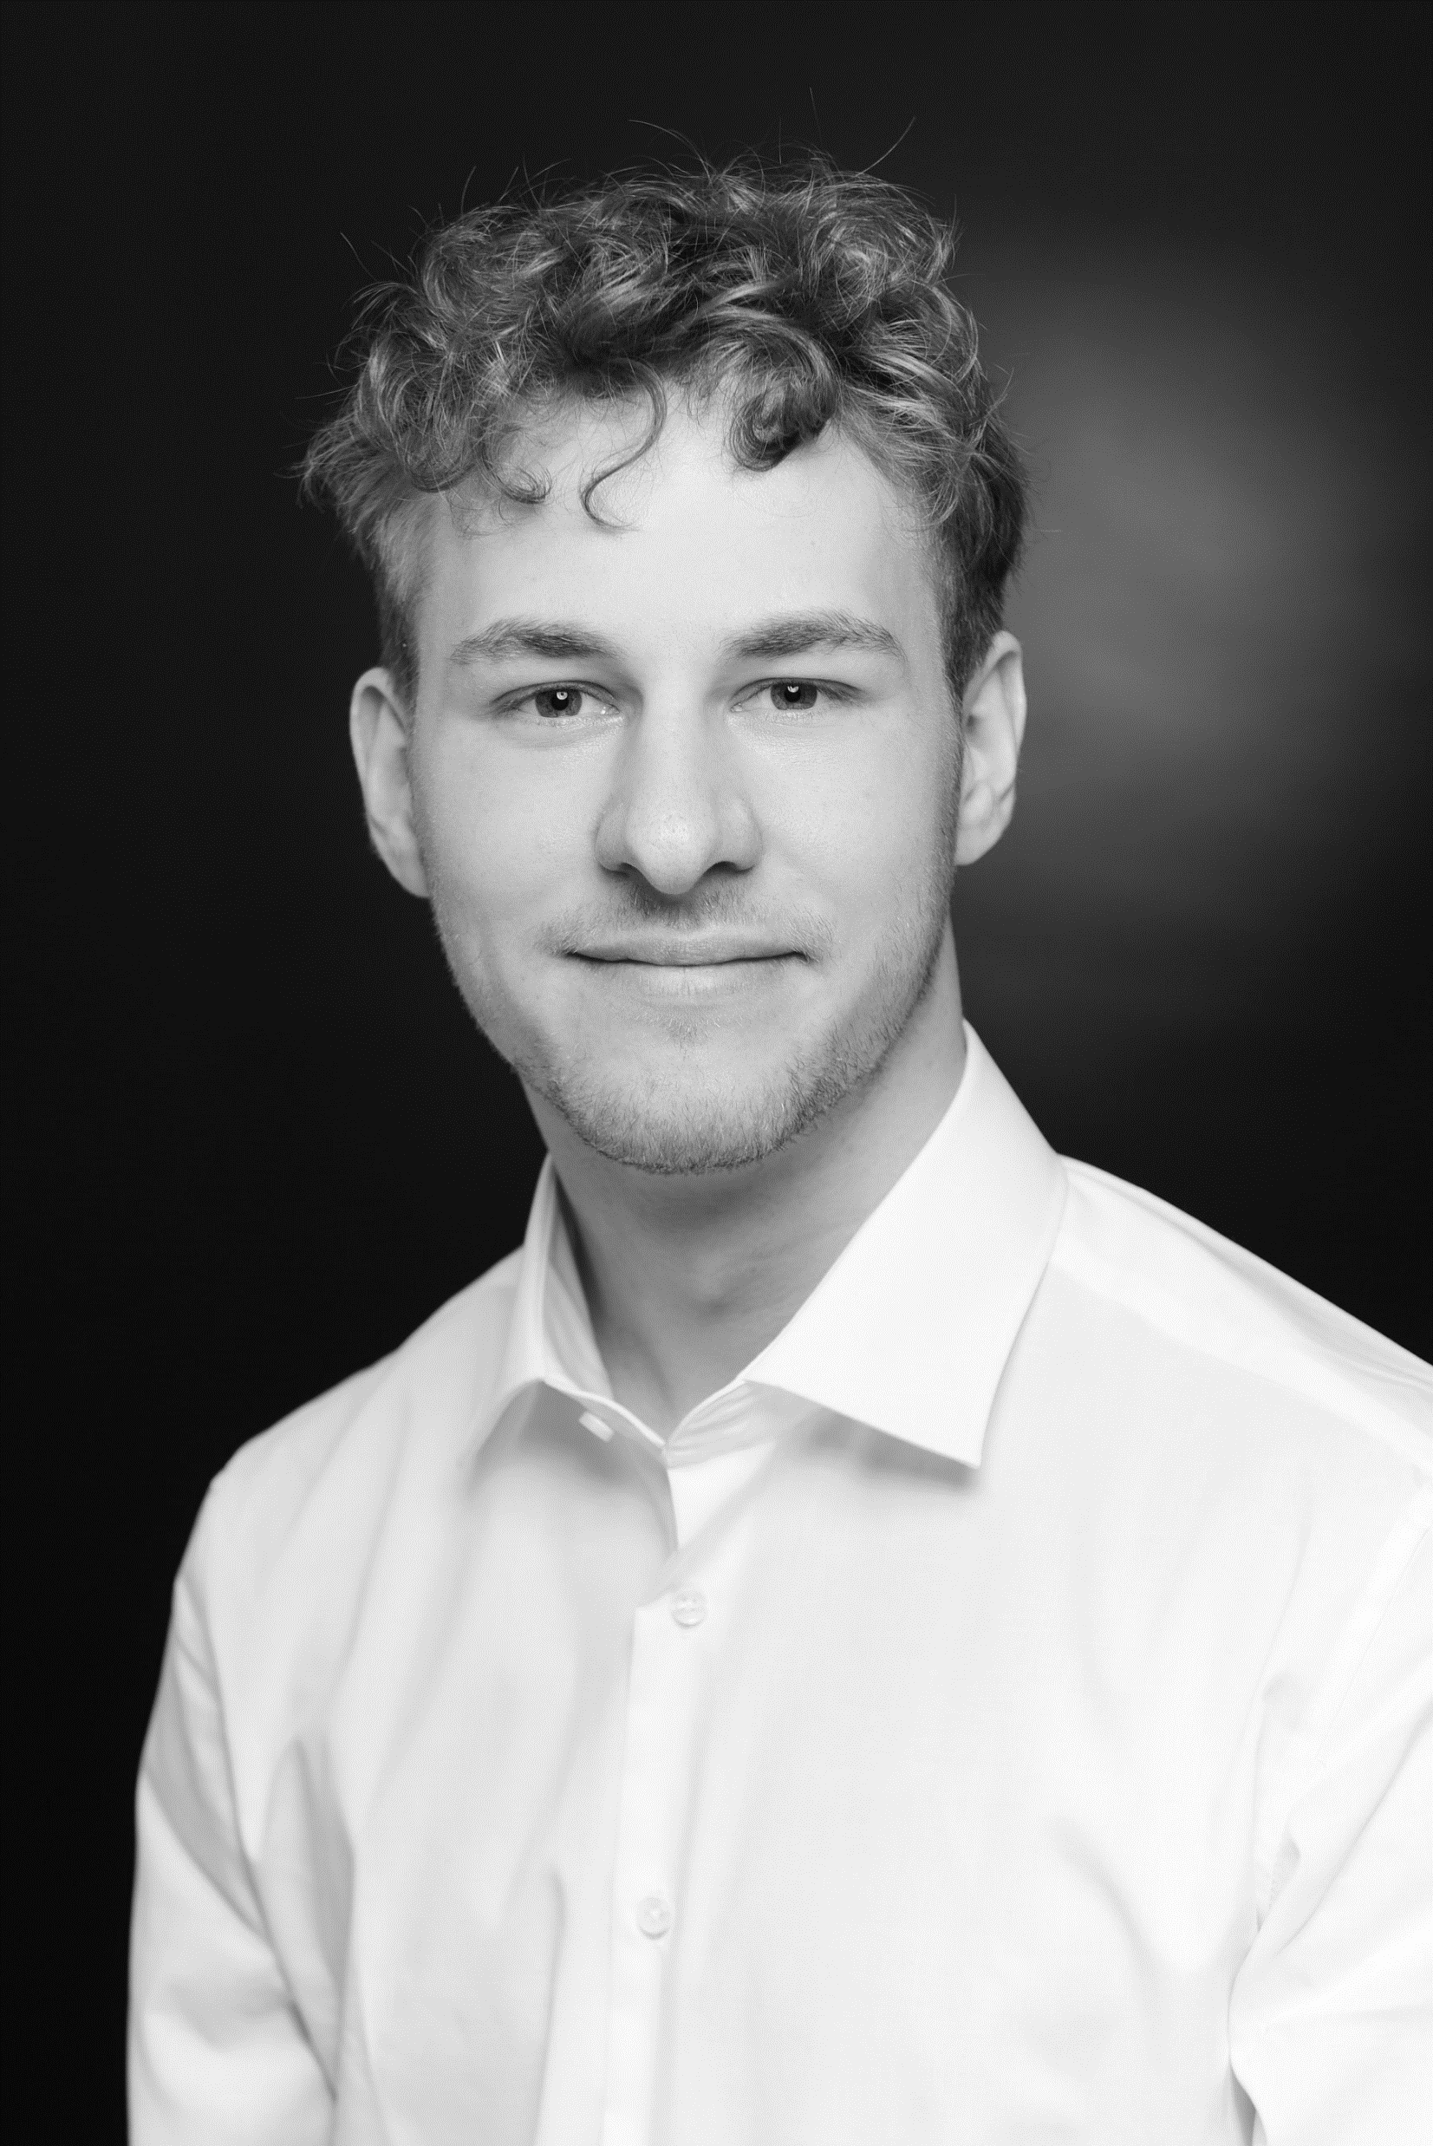


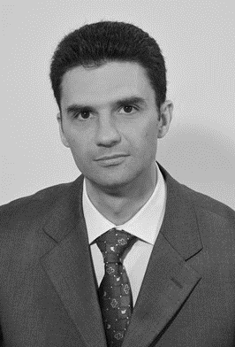
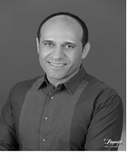

Consultant Overview
The consultant overview shows the consultants preselected for the project purpose. A second line of consultants is available for continuity planning reasons for each country.
Core capabilities
Country
Delivery mgr
David Faustmann
Mng. Director/ Project Responsible/ PM
Large Project Management: Extensive experience in managing large and multi-party projects in Energy/ Utilities Industry
Cultural Development and Management System Introduction: Conduction of a high number of Bradley Curve conform safety culture projects and introduction of ISO conform measures
Germany
Project Support
Tim Möller
Consultant/ PMO & Data Mgmt.
Data Orientation: Preparation and conduction of a range of surveys in a Mindfulness and Health context incl. the deduction of suitable measures
Project Management & Communication: Support of Project Management and especially communication activities during safety projects
Germany
Experts
Christopher Spalek
Expert & Deputy PM
HSE Project Management: Development and implementation of HSE Projects during +15 years in different HSE Leadership roles for a multi-national company
HSE-Culture and ISO 45001: Execution of a high range of safety culture project (Bradley Curve conform) and introduction of integrated Management Systems at clients
UK | Germany
Iulian Gherman
Expert
Strategic Safety Leadership: Extensive experience in program management for multinational safety projects with proven success in performance improvement.
Safety System Development: Proficient in establishing comprehensive safety networks and driving corporate operational discipline in safety management.
Romania
Calin Dragulanescu
Expert
Systems Implementation & Safety Consulting: Proficient in leading management system certifications and safety culture transformations for multinational companies.
Operational Process Optimization: Skilled in managing consultancy projects and optimizing business processes across a variety of industries.
Romania
Serkan Gurkan
Expert
Maritime QHSE Leadership: Expert in maritime safety, quality, and environmental systems with substantial shipyard management experience.
Systems Audit and Implementation: Skilled in auditing and implementing comprehensive management systems in the marine industry.
Turkey

Slide 47


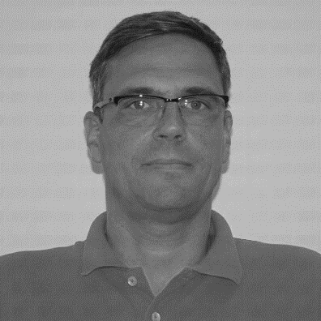

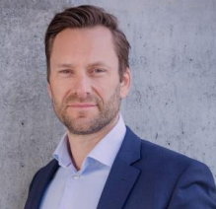

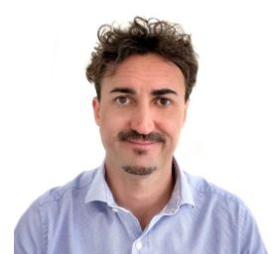

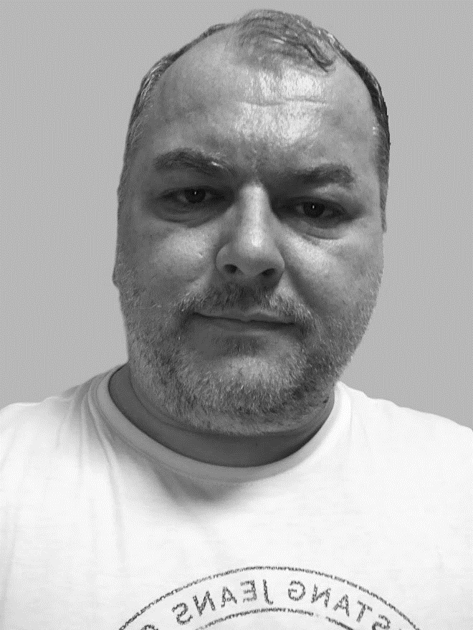






Consultant Overview
Core capabilities
Country
Experts
Marzena Pawłoska
Expert
HSE Strategy and Compliance: Expert in HSE regulatory compliance across various sectors, excelling in audit preparation and safety standard enhancement.
Educational Leadership and System Implementation: Skilled in leading HSE education and implementing Integrated Management Systems to bolster organizational safety.
Poland
Marko Groš
Expert
Development & Training: Management training, Assessment, Contractors Safety, Safety Champions coaching, Training and communication.
Auditing & Compliance: Extensive experience in various ISO audits (9001, 14001, 45001) across various sectors and extensive operational excellence experience in a leading role.
Croatia
Pontus Åstrand
Expert
Development & Training: Specializes in improving quality, environment, sustainability, and health & safety within organizations, including targeted training programs.
Auditing & Compliance: Extensive experience in ISO audits (9001, 14001, 45001) across various sectors, focusing on implementing effective management systems.
Sweden
Gabriele Vigano
Expert
HSE and ISO System Expertise: Proficient in managing health, safety, and environmental systems, with a strong focus on compliance and ISO standards.
Safety and Environmental Strategy: Experienced in strategic consultancy, audit leadership, and risk management across various industries.
Italy
Marek Fic
Expert
HSE and ISO System Expertise: Proficient in managing health, safety, and environmental systems, with a strong focus on compliance and ISO standards.
Safety and Environmental Strategy: Experienced in strategic consultancy, audit leadership, and risk management across various industries.
Slovakia | Czech Rep.
Béla Cseh
Expert
Safety Leadership: Proficient in multinational safety program management and performance improvement.
Operational Safety Systems: Expert in establishing and coaching on corporate safety disciplines and management systems.
Hungary
Dr. Peter Schneider
Expert
Safety Leadership: Former EHS Lead and Technology lead (Governance Director of a 55,000 employees company, led 200 engineers)
Operational Safety Systems: Managed 24/7 shift operations, ensuring high safety standards, optimal production efficiency and high quality
Netherlands

Slide 48
0
Management Summary
1
Our Understanding of Your Situation
2
Our Solution and Risk Mitigation Approach – Overview
Components of the Solution Approach – Detail
3.1. Phase 1 – Kick-Off and Data Analysis
3.2. Phase 2 – Heat Map Risks
3.3. Phase 3 – Leadership & HSE Capabilities
3.4. Phase 4 – Cultural Maturity
3.5. Reporting and Usability – Consolidation for E.ON HSE Governance
3.6. Summary of Activities & Assumptions
3
4
Our Program Setup – Flexible Proposal
4.1. Program Organization, Team, Team Experience
4.2. Planning
4.3. Commercial Aspects
4.4. CVs
5
References
6
Appendices

Slide 49
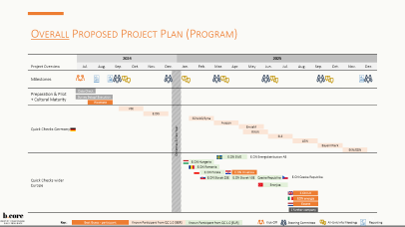
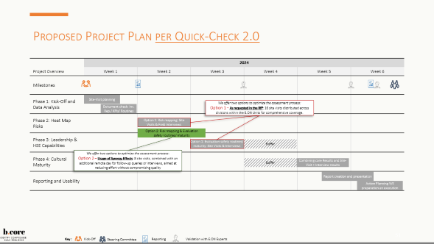
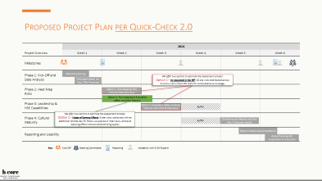

Project Planning includes Considerations to smoothen the Execution and to make use of Efficiency Opportunities
Overall Project planning (Program)
Proposal: The overall planning should respect the sequence of the Quick Check 1.0 to allow the previous candidates for the same evolution period
Consideration: This does not count for countries with potentially very low temperature (site visits) during Q4 and Q1 of the years – a shifting has been proposed
Proposal: Although a Europe-wide launch is possible ad-hoc, we propose to start in Q1 2025 for non-German participants. This prolongs the international alignment period and allows an ‘en-bloc’ approach with intensive exchange.
Project planning per Quick Check
Steadiness consideration: Overall the project plan per (unit) Quick Check 2.0 follows up on the sequence of Quick Check 1.0.
Nevertheless, the Phase logic laid down in the RfP is followed
By replicating a known logic, involved (experienced) participants will reduce alignment work and can assist unexperienced peers/ participants
Efficiency consideration: We have introduced an Option 2 (considering the requested Option 1 by the RfP) to reduce On-Site effort on E.ON sites as well as project costs.
E.ON is – of course – free to decide which option is suitable.
See details on following pages

Slide 50
Overall Proposed Project Plan (Program)
 | 2024 |  |  |  |  |  | 2025
Project Overview | Jul. | Aug. | Sep. | Oct. | Nov. | Dec. | Jan. | Feb. | Mar. | Apr. | May | Jun. | Jul. | Aug. | Sep. | Oct. | Nov. | Dec.
Milestones
Preparation & Pilot + Cultural Maturity
Quick Checks Germany
Quick Checks wider Europe
Christmas & New Year
Data Check
Survey Setup/ Execution
Westnetz
VSE
E.DIS
SÜWAG/Syna
Avacon
EnviaM
RWW
ELE
LEW
BayernWerk
EKN/EDN
E.ON SWE
E.ON Energidistribution AB
E.ON Hungaria
E.ON Romania
E.ON Polska
E.ON Hrvatska
E.ON Slovak ZSE
E.ON Slovak VSE
Czeska Republika
E.ON Czeska Republika
Enerjisa
E.ON UK
EON energia
Essent
1 further company
Key :
Best Guess - participant
Known Participant from QC 1.0 [GER]
Known Participant from QC 1.0 [EUR]
Kick-Off
Steering Committee
All-Unit Info Meetings
Reporting

Slide 51
Proposed Project Plan per Quick-Check 2.0
 | 2024
Project Overview | Week 1 | Week 2 | Week 3 | Week 4 | Week 5 | Week 6
Milestones
Phase 1: Kick-Off and Data Analysis
Phase 2: Heat Map Risks
Phase 3: Leadership & HSE Capabilities
Phase 4: Cultural Maturity
Reporting and Usability
Site-Visit planning
Dokument check: Inv. Rep./ KPIs/ Routines
We offer two options to optimize the assessment process:
Option 1 – As requested in the RfP: 16 site visits distributed across divisions within the E.ON Units for comprehensive coverage.
Option 1: Risk mapping: Site Visits & Field Interviews
Option 2: Risk mapping & Evaluation safety routines/ maturity
Option 1: Evaluation safety routines/ maturity: Site Visits & Interviews
Buffer
We offer two options to optimize the assessment process:
Option 2 – Usage of Synergy Effects: 8 site visits, combined with an additional remote day for follow-up queries or interviews, aimed at reducing effort without compromising quality
Buffer
Combining core Results and Site-Visit + Interview results
Report creation and presentation
Action Planning WS preparation an execution
Key :
Kick-Off
Steering Committee
Reporting
Validation with E.ON Experts

Slide 52
Expected Effort for E.ON Resources during the Quick Checks
Understanding Effort on E.ON Side and it’s Drivers
Visualization of Efforts per Quick Check
Efforts are broken down per quick check. This is also valid for global activities mainly covered by E.ON PM
For E.ON Safety Experts, the effort driver are Site-Visits. We assume a full coverage by one person per site – this is a maximum. While b.core consultants have to be accompanied, this task can be covered by other qualified personnel
For leadership and staff, the effort drivers are discussion/ interviews in-field we assume a max of 4 hours of discussions and interviews per role
Effort of Staff and Leadership depends on company size – duration per survey is max. 20 min. per person
Project phases & tasks | E.ON (global and local) Days per Profil and Unit-Specific Quick-Check
 | E.ON PM | E.ON Safety Experts | E.ON Leadership Team | E.ON Staff
Phase 1 - Phase 1 – Kick-Off and Data Analysis | 1 | 2,0 | 0,1 | 0,0
Phase 2 – Heat Map Risks | 0,0 | 4,5 | 0,5 | 0,5
Phase 3 – Leadership & HSE Capabilities | 0,0 | 4,0 | 0,5 | 0,5
Phase 4 – Cultural Maturity | 0,0 | 0,2 | 20min. p.P. | 20min. p.P.
Reporting and Usability | 0,5 | 0,0 | 0,5 | 0,0
Sum | 1,5 | 11 | 1,6 | 1
Survey Execution

Slide 53
0
Management Summary
1
Our Understanding of Your Situation
2
Our Solution and Risk Mitigation Approach – Overview
Components of the Solution Approach – Detail
3.1. Phase 1 – Kick-Off and Data Analysis
3.2. Phase 2 – Heat Map Risks
3.3. Phase 3 – Leadership & HSE Capabilities
3.4. Phase 4 – Cultural Maturity
3.5. Reporting and Usability – Consolidation for E.ON HSE Governance
3.6. Summary of Activities & Assumptions
3
4
Our Program Setup – Flexible Proposal
4.1. Program Organization, Team, Team Experience
4.2. Planning
4.3. Commercial Aspects
4.4. CVs
5
References
6
Appendices

Slide 54
Pricing and Options Overview
Based on the projected schedule provided in the RfP, we're gearing up for a Q3 2024 project initiation. This timeframe will encompass the 18-month duration required for the 25 Quick Checks 2.0, as outlined. We've structured our approach with two options to accommodate the project's needs, ensuring flexibility and efficiency throughout the process.
We offer the service by the fixed price and fixed travel costs as displayed below. The following excludes VAT:
Pricing (plus travel costs)
Calculation
The estimation for the HSE Quick Check 2.0 project is structured as per details in the RfP, covering an 18-month period from Q3, 2024, as stipulated.
These figures are for one E.ON unit, with 25 units in total planned for assessment.
Should the actual required efforts and costs deviate, the attached 'Excel Price Sheet' remains the reference document for all calculations.
We offer two options to optimize the assessment process:
Option 1: 16 site visits distributed across divisions within the E.ON Units for comprehensive coverage.
Option 2: 8 site visits, combined with an additional remote day for follow-up queries or interviews, aimed at reducing effort without compromising quality.
The total efforts and costs per Quick Check 2.0 are summarized below:
Consultant | Man-days | Costs option 1 | Costs option 2
Managing Director | 2
Local Expert | Option 1: 16 Option 2: 13
Project consultant | 4,5
Total | ~22,5/ ~19,5 | 36.900,00€ | 31.800,00€
Discount 5% |  | -1.845,00€ | -1.590,00€
New Total |  | 35.055,00 € | 30.210,00 €
Additional fixed Rate for travel costs | in Höhe von | 2.000,00€ | 1.000,00€

Slide 55
Invoicing
The offer assumes that E.ON will fulfill the cooperation obligations described. On this basis, invoicing for each Quick Check will be carried out as a fixed price as follows:
As mentioned previously the pricing is to be considered excl. VAT. We expect the participation of 25 E.ON to which this model applies.
For Non-German E.ON units the Reverse Charging Procedure applies. These countries are (considering the scope of the project): Italy, the Netherlands, Poland, Romania, Sweden, Slovakia, Czech Republic, Hungary, UK.
Additional services or consultant man-days can be purchased as follows
The specified monthly billing amount (plus VAT, applicable in Germany) is payable 15 days after invoice receipt, with a 3% discount in accordance to E.ON terms. If payments are executed after this period, an undiscounted payment amount applies.
Frequency | Option 1 | Option 2
End of Project Month 1 | 20.000€ | 20.000€
End of Project Month 2 | 15.055€ | 10.210€
travel costs in applicable Month | 2.000€ | 1.000€
Service | Rate
If required, hosting of Survey Platform for max 70.000 conductions | Included
Translation of (one) ‘final’ Quick Check Report to local language | Included
Translation of additional (e.g. Survey) reports to local language (per report) | 1.700€
Site-Visit day/ Workshop day | 1.700€
travel costs (if applicable) | 250€/day

Slide 56
Terms of Contract
This offer is based on the General Purchasing Conditions of E.ON as retrieved on 02.04.2024. Should components of this offer not be governed by the aforementioned conditions, the terms of this offer shall apply.
The conditions of the offer also apply if the acceptance of the offer is declared through an automated order form and the offer is not explicitly referenced or only the technical part of the offer is referred to in the form.
There are no oral agreements. Any amendments and supplements to this offer must be in writing. This also applies to any waiver of the requirement for written form.
Should any provisions of the resulting contract be invalid or unenforceable, this does not affect the validity of the rest of the contract. In place of an invalid or unenforceable provision, a regulation closest to the economic purpose of the invalid or unenforceable provision will apply.

Slide 57
Order Placement and Binding Period
We appreciate the opportunity to submit this offer, which we will honor for a period of two months.
If you agree to the terms of this offer, please sign the second copy legally and return it to us.
Alternatively, we accept the acceptance of the offer through an automated order form.
We are at your disposal for any further inquiries.
Essen, 17.04.2024
b.core consulting GmbH
David Faustmann

Slide 58
0
Management Summary
1
Our Understanding of Your Situation
2
Our Solution and Risk Mitigation Approach – Overview
Components of the Solution Approach – Detail
3.1. Phase 1 – Kick-Off and Data Analysis
3.2. Phase 2 – Heat Map Risks
3.3. Phase 3 – Leadership & HSE Capabilities
3.4. Phase 4 – Cultural Maturity
3.5. Reporting and Usability – Consolidation for E.ON HSE Governance
3.6. Summary of Activities & Assumptions
3
4
Our Program Setup – Flexible Proposal
4.1. Program Organization, Team, Team Experience
4.2. Planning
4.3. Commercial Aspects
4.4. CVs
5
References
6
Appendices

Slide 59
Project Staffing
b.core plans the availability of the named consultants and subcontracted consultants for the proposed program start. However, b.core reserves the right to change or exchange the 'b.core project consultant,' but will replace them with consultants of equal qualification.
b.core may bring in additional qualified consultants according to the technical and capacity requirements during the program. E.ON will allow b.core to deploy additional consultants (Senior-Level) after prior discussion and agreement to support the team. Billing modalities will be agreed upon mutually.
E.ON will refrain from anything that could jeopardize the independence of b.core’s consultants. This is especially true for offers of employment and for offers to conduct assignments on their own account.
The consultants of b.core will not be integrated into E.ON’s operations. They are not subject to E.ON's directives, but exclusively to b.core’s management authority. The number and choice of consultants who provide the services remain reserved within the above regulations by b.core just as any other personnel organizational authority.
According to the RfP, b.core is entitled to deliver part of the services differently from the program location ("remote") in its own premises.

Slide 60

Visiting sites in:
RESUME
PROJECT REFERENCES (EXTRACT)
+10 years of experience, primarily in the energy sector
Consulting on the implementation of management systems according to various ISO standards
Consulting on transformation projects
Consulting on process optimization projects
Consulting for digitalization projects
Program and project management at an international level
Program Management
Program management for a major German telecommunications provider during the SAP implementation across 13 national subsidiaries
Program management for a Europe-wide project on cross-border capacity allocation involving 14 energy transmission system operators and 4 European electricity exchanges
David Faustmann
EXPERTISE
Management Systems and Culture Change Programs
Execution and program management of safety culture change programs within the investments of a key player in the German energy industry, along with similar implementations in other companies within the energy sector and other industries
Introduction of management systems according to ISO standards (45001, 55001, 9001) for distribution system operators; ensuring certifiability
MANAGING DIRECTOR
Energy Industry
Digital Transformation
Telecommunications
Supply Chain
faustmann@bcoreconsult.com
Manufacturing
EDUCATION
Transformation
Redesign of the operating model of a trading house, including the design of roles and responsibilities, processes
+49 (0) 176 5672 3637
B.Sc. & M.Sc. Sales Engineering and Product Management, Ruhr University Bochum
Practitioner Prince II
Solution-oriented conflict management
Process management
German & English
Digitalization
Implementation of a digitalization program consisting of 48 individual digitalization projects, with a scope ranging from strategic planning and sequencing of projects to implementation

Slide 61





RESUME
PROJECT REFERENCES (EXTRACT)
Extensive expertise in empirical social research, data analysis, and statistical evaluation
Development of management tools and implementation as a web application
Creation of social media surveys and posts
Conceptualization and execution of surveys, capable of crafting and implementing customized questionnaires
Safety Culture Program Implementation
Supporting a safety culture program, focusing on strategy, coordination, and execution.
Developed and executed communication strategies to promote safety awareness and engagement.
Implemented safety objectives and routines, integrating them into daily practices to enhance the safety culture.
Data oriented Projects
Creation and execution of a descriptive survey on job satisfaction
Administration of the Mindfulness Questionnaire FFMQ-D
Development and execution of a mindfulness training based on the Dick and Carey instructional model
Development and execution of pre- and post-tests to assess the effectiveness of the mindfulness training
Investigation of the impact of cognitive effort on risk assessment of Covid-19
Investigation of the impact of context and order in the evaluation of attributes in product descriptions by Paranormal Believers
Tim Möller
EXPERTISE
PROJECT CONSULTANT
Energy Industry
Project Management
Survey Conduction
Psychological Assessment
Instructional Design
Data Analysis
EDUCATION
B.A. in Educational, Learning, and Training Psychology/Management
M.Sc. in Psychology with a focus on Teaching, Learning, and Competence Development
German & English

Slide 62


Expert visiting sites in:
RESUME
PROJECT REFERENCES (EXTRACT)
+15 Years International Leadership Experience in HSE Roles for production Companies
+10 Years of QHSE Consulting Experience in Management system Introduction and Process Optimization
Implementation of QHSE Management Systems
Behavior Based Safety Program Introduction
Lead Auditor for 9001 14001 45001 50001
Organization & Management
Development and advancement of the global HSE organization, followed by a company-wide reduction in accident rate by over 40% at a food packaging company.
Christopher Spalek
Program / Project Management
Global implementation of a behavior-based safety program at a food packaging company.
Leadership of the European team for the reduction of ergonomically induced musculoskeletal disorders for a global multi-technology company.
Introduction of a global system for the recording and analysis of accidents, including associated reporting.
Implementation of a global HSE Management System for a medium-sized company with over 4,000 employees and 10 locations.
EXPERTISE
Expert
Energy
Electronics
Chemical
Supply Chain
Production
EDUCATION
Audits & Certification
Conducted over 100 certification audits as Lead Auditor across various industries for management systems according to OHSAS 18001, ISO 45001, ISO 14001, and ISO 9001.
HSE culture assessment at various network operators in Germany.
Dipl.-Ing. Safety Engineering (Wuppertal)
Environmental Management (Hagen)
PMP
IRCA Auditor 9001, 14001 45001
Six Sigma Blackbelt/Green Belt Coach
ICF ACC Associated Certified Coach
German & English

Slide 63






Visiting sites in:
RESUME
PROJECT REFERENCES (EXTRACT)
+14 Years of HSE Experience across Various Industries
Expert in Workplace Safety Improvement and HSE Audits
Developed and Managed HSE Processes, Policies, and Trainings
Coordinated Implementation of ISO 9001, 14001, 45001 Management Systems
Internal Auditor and Educator in HSE Practices and Risk Assessment
Regulatory Compliance & Safety Enhancement
Led monitoring and adaptation to Polish regulatory updates for industries including power generation and construction, ensuring international compliance.
Prepared diverse workplaces for safety audits, significantly enhancing regulatory compliance and safety standards.
HSE Process Management & Training Development
Managed HSE processes across various sectors, developing comprehensive safety plans and conducting extensive staff training.
Implemented solutions to extend OHS policy, achieving notable improvements in workplace safety and compliance.
Risk Management & Safety Certification
Conducted detailed risk assessments and work method statement verifications, enhancing safety and risk management.
Ensured compliance with the Safety Certificate Contractors system, improving subcontractor management in safety, health, and environmental standards.
Departmental Setup & Integrated Management System Coordination
Established the HSE department from scratch, aligning with strategic goals and legal requirements.
Coordinated the implementation of Integrated Management Systems, enhancing safety culture and organizational compliance.
Marzena Pawłoska
EXPERTISE
Expert
Workplace Safety
HSE Audits
Regulatory Compliance
Monitoring
Risk Assessment
ISO Management Systems
EDUCATION
Mgr Sc. in Economics (University of Economics and Business - Wroclaw)
Environmental Protection Manager (University of Economics and Business - Wroclaw)
OHS Senior Inspector (University of Economics and Business - Wroclaw)
Compendium MBA (QUEST Change Managers)
International Leadership and Management Training (Japan, Germany, Sweden)
SCC Training
SEP Category D1, D2, D3
Internal Auditor ISO 45001:2018, ISO 14005:2015, ISO 9001:2009
Occupational Health and Safety Training (Poland)
Polish & English (B1)

Slide 64
Expert visiting sites in:
RESUME
PROJECT REFERENCES (EXTRACT)
+15 Years Experience in Quality and HSE
Expert in Operational Excelence
15 Years experience as Head of Quality control in Energy transmission
Auditor and Educator in HSE Practices and Risk Assessment
Safety Culture Change
Management training, Assessment, Contractors Safety, Safety Champions coaching, Training and communication etc.
Management Systems
Auditing management system in accordance with ISO 9001 for quality management, ISO 14001 for environmental management and OHSAS 18001 for occupational health and safety.
Auditing management system in accordance with ISO 9001 for quality management, ISO 14001 for environmental management, ISO 45001 for occupational health and safety and ISO 50001 for energy
Verification of reports on greenhouse gas emissions
Auditing management system in accordance with ISO 9001 for quality management, ISO 14001 for environmental management, ISO 45001 for occupational health and safety and ISO 50001 for energy management
Marko Groš
EXPERTISE
Expert
Workplace Safety
HSE Audits
Regulatory Compliance
Monitoring
Risk Assessment
ISO Management Systems
EDUCATION
Mechanical Engineering University of Zagreb
Croatian & English

Slide 65
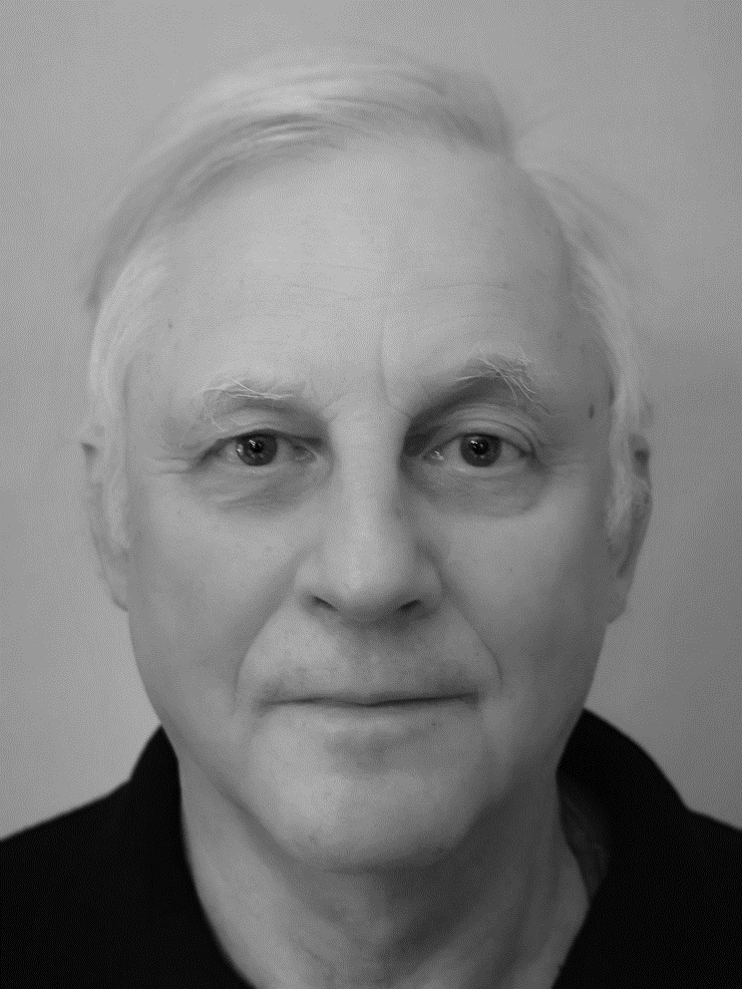

Expert visiting sites in:
RESUME
PROJECT REFERENCES (EXTRACT)
Picture
7 years Shipping and Shipbuilding companies including seagoing enginer and Superintendent working in shipyards in Poland, Spain and Croatia
10 years Ship and Engineer Surveyor for Lloyd’s Register
over 20 years Auditing experience for LRQA in ISO 9001/ ISO 14001/ ISO 45001/ ISO 28000
Consultant for implementation of International Safety Mangement Code ( ISM ) for shipping companies
Trainer for Global Wind Organisation
Auditor of Global Wind Organisation – Safety for the Wind Technicians
Program Management
Implemented the Safety management Code for the Shipping Companies including Polsteam, Polferries and Chipolbrok
Developed the Auditor training for the Auditors in the Wind Industry ( Safety and Technical competencies0
Leszek Sitkowski
EXPERTISE
Management Systems & Culture Programs
Audited International Safety Management systems in the Shipowners offices (UK, Poland and Cyprus) and on board of many ships with different crew nationalities
Audited Safety Training for Wind Technicians in UK, Germany, Poland, Hungary, China , Korea and Thailand
Consultant
Energy
Power generation
Maritime
Supply Chain
ls.Sitkowski@gmail.com
Production
Audits & certification
Conducted over 100 certification audits as Lead Auditor across various industries for management systems according to OHSAS 18001, ISO 45001, ISO 14001, ISO 9001,ISO 28000 ISM and GWO
?
+48 601 748 053
EDUCATION
Dipl. Engineer Gdansk Technical University ( Maritime engineering)
Postgraduate Course of Management Gdansk University Faculty of management
Lead Auditor ISO 9001/ ISO 14001/ ISO 45001/ ISO 28000 /ISO 50001 and GWO
Polish ( natives spoken)
English, German, Spanish,
Croatian

Slide 66



Visiting sites in:
RESUME
PROJECT REFERENCES (EXTRACT)
+100 audit days per year as Senior Lead Auditor for ISO 45001
Approved provider of health and safety trainings by AFA, Sweden
+700 audit days experience with ISO 9001:2015 and ISO 14001:2015
+400 audit days experience with ISO 45001:2018
Expert in management system implementation and auditing across various industries globally
Audits & Certification
Led the development and implementation of ISO 9001, ISO 14001, and ISO 45001 management systems for diverse organizations.
Designed and delivered tailor-made trainings in occupational health and safety specifically for companies within the construction industry.
Risk Management & Coaching
Facilitated risk management workshops focusing on occupational health and safety, enhancing company-wide awareness and mitigation strategies.
Provided brain-based leadership coaching, aiding in the development of leadership skills with a focus on psychological insights for improved management effectiveness.
Process Development & Compliance
Conducted process development workshops aimed at enhancing operational efficiencies and compliance with regulatory standards.
Spearheaded the implementation of the CSRD directive, ensuring companies align with sustainability reporting standards.
Pontus Åstrand
EXPERTISE
Expert
Health & Safety
Risk Management
Process Development
ISO Management Systems Implementation and Auditing
CSR & Environmental Sustainability
EDUCATION
Corporate Sales (IHM Business School)
Neuroleadership coach (Neuroleadership institute)
Lead auditor (Canea)
Senior Lead auditor (CQI/IRCA)
CSRD Auditor (Intertek academy)
Swedish, English

Slide 67
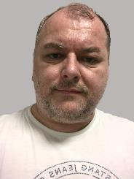
Expert visiting sites in:
RESUME
PROJECT REFERENCES (EXTRACT)
20+ Years experiences in various industries, mainly Automotive, Mechanical Engineering, Oil & Chemicals, Electrotechnics and Energetics
Experiences as consultant and certification auditor for various ISO standards
Expert for explosion protection (ATEX) and major industry accidents (SEVESO)
Experienced consultant in Behavioural Based Safety programs and Process Safety Programs
SEVESO projects
Categorization of local plants according to SEVESO principles into risk category, major industry accidents risks assesment and implementation of countermeasures for big Steel Factory, Chemical Factory, Electrotechnics Production, Cement Factory and Can Production Factory
Explosion prevention (ATEX) projects
Classification of explosion areas, explosion risks assessment, identification and implementation of explosion countermeasures, explosion rootcause analysis and trainings and coaching for big Rafinery and its related production and sale including big delivery terminals and small fuel stations, as well as for big Steel Factory, Brewery, Gas distribution company, Alluminium production factory, many factories in field of Mechanical Engineering, Electrotechnics and Automotive industry
Marek Fic
EXPERTISE
Expert
Automotive
Mechanical Engineering
Oil and chemicals
Electrotechnics
Behavioral Based Safety projects
Behavioral Safety Assessment and related Consulting and Coaching for top and line managers at big Consumer Goods Corporation, Milk Processor and Cheese Producent Corporation, Plant-based foods Corporation, Energetics Corporation and Chemical Production Corporation
Production
EEDUCATION
M.Sc. Quality Production and Safety of Technical Systems at Technical University of Kosice
Lead auditor for ISO9001, ISO14001, ISO45001, ISO27001, ISO22301, ISO20000-1
Specialists for Prevention of Major industry accidents (SEVESO)
Safety Technician and Fire Technician
Management systems
Certification and consultation for more than 150 various companies in Slovak Republic and Czech Republic according to standards for Quality, Environment, Safety Systems and Information Security
Performance of trainings and coaching for top and line managers and internal and lead auditors in related areas
Slovak & Czech &
Polish & English

Slide 68
Expert visiting sites in:
RESUME
PROJECT REFERENCES (EXTRACT)
Over 39 years of experience in various managerial and supervisory roles focus on workplace and process safety consultant
Prior Vice President SD&HSE in MOL Group
Expert for corporate sustainable development and HSE management systems
Experienced consultant in Safety awareness training, Leadership coaching and training
SEVESO projects
Program manager for Safe Workplaces Project with significant improvement of safety performance indicators in four years, as a result of an international, multi-site group of companies’ efforts.
Development of Corporate Operational Discipline (Chemicals)
Enabling a group of companies become self-sufficient to sustain the safety improvement program by "train the trainers" technique and establishment of a large, dedicated workplace and process safety network.
Béla Cseh
EXPERTISE
Expert
Automotive
Mechanical Engineering
Effective Felt Leadership (Manufacturing)
Assessment and development of safety management system and practice, training and coaching of operational leaders to develop their influential safety management skills.
Oil and chemicals
Electrotechnics
Production
EEDUCATION
Graduate mechanical engineer, chartered welding specialist engineer, Technical University of Budapest
Certified in Business Management Studies, JICA Tokyo
Certified in Oil and Gas Risk Management, University of Calgary
Trained Coach
Hungarian, English,
German

Slide 69
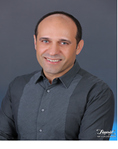
Expert visiting sites in:
RESUME
PROJECT REFERENCES (EXTRACT)
Totally 25 years experience in ship building, ship repair and maintenance sector.
10 years experience as marine surveyor in Bureau Veritas
9 Years Leadership Experience in HSE Roles for a Shipyard
Implementation of QHSE Management Systems
Lead Auditor for 9001 14001 45001 30000 10002
Program Management
To lead the HSE Department in order to implement health and safety practices within shipyard in accordance with national laws and regulations and to create and develop health and safety culture.
To lead the Quality Control Department in order to ensure that all process regarding the shipbuilding, maintenance and repair are carried out in accordance with national and international standards.
Serkan GURKAN
EXPERTISE
Management Systems & Culture Programs
Implementation of a HSEQ Management System for a medium-sized Shipyard.
Expert
Naval Architecture& Marine Engineer, Lead Auditor
Marine Engineering
Inspection
Maritime Operations
Audits & Certification
Conducted over 100 certification audits as Lead Auditor/Team Member across various industries for management systems according to ISO 45001, ISO 14001, ISO 9001, ISO 30000 and ISO 10002
Safety Management Systems
EDUCATION
Naval Architecture & Marine Engineering (İstanbul Technical University)
Exemplar Global Auditor 9001 14001 45001
Turkish & English

Slide 70
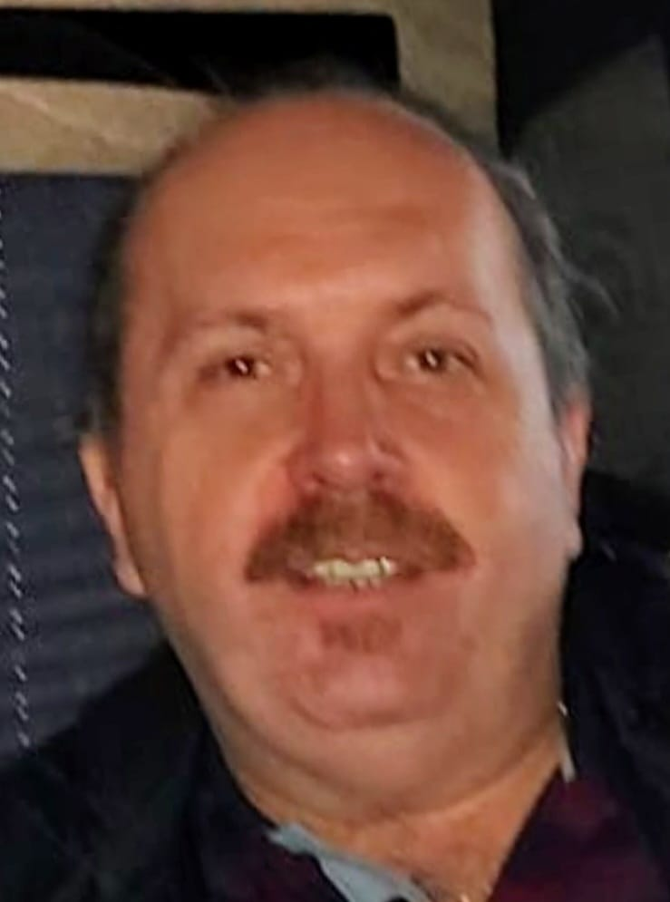
Expert visiting sites in:
RESUME
PROJECT REFERENCES (EXTRACT)
+9 Years International Leadership Experience in QHSE Roles for production Companies
+23 Years of QHSE Consulting & Auditing Experience in Management Systems
Implementation of QHSE Management Systems
Lead Auditor for 9001 14001 45001 50001 30000 37001
Organization & Management
Establishment and improvement of HS for a global Telecommunication company for Safety Culture Program focusing on potential fatal hazards on site during operations
Establishment and improvement of QHSE Management for a petro-chemical rafinery for contunious improvement of its QHSE Management System.
Establishment and improvement of QHSE and Energy Management System for a Hydro Electric Power Plant.
Establishment and improvement of QHSE for an Organized Industrial Zone Management
Establishment and improvement of QHSE for a Natural Gas Provider.
T.Cagan Mesci
EXPERTISE
Consultant
Utilities
Construction & Mining
Telecommunication
Supply Chain
Production
Automotive
Audits & Certification
Conducted over 2500 certification audits as Lead Auditor across various industries for management systems according to OHSAS 18001, ISO 45001, ISO 14001, ISO 9001 ISO 30000 and ISO 37001
Conducted over100 Supplier audits across various industries for management systems according to OHSAS 18001, ISO 45001, ISO 14001, and ISO 9001
Conducted over 30 assessments for Ship Dismantling Industry for SRFP (Ship Recycling Facility Plan) including Hong Kong Convention.
Energy
Ship Building & Ship Dismantling
EDUCATION
Dipl.-Ing. Industrial Engineering
Computer Administration Program Graduation
Lead Auditor certificates for ISO 9001, 14001 45001 30000 and 37001
English, Turkish, Azeri

Slide 71




Expert visiting sites in:
RESUME
PROJECT REFERENCES (EXTRACT)
+20 years of experience in high risks industries
Consulting on the introduction of management systems according to various ISO standards
Leading cultural transformation projects for top multinational companies, across Europe
Program and project management at an international level
Project Management
Project Management in multi-annual Safety Culture Change project for a multinational company (5 factories on 4 continents, Chemistry)
Project Management in multi-annual Safety Culture Change projects in Oil and Gas for multinational companies.
Project Management and Business Development for many local Safety Projects with multinational companies (various industries)
Iulian Gherman
EXPERTISE
Expert
Management Systems and Cultural Change Programs
Management Systems Coordinator and implementation of ISO 9001 and 14001 in a major factory (multinational company, food industry).
Leading Cultural Change programs (Principal Consultant, Lead Consultant, Senior Consultant) for more than 15 years, with multinational companies, in Romania and abroad. Expertise: Assessment, Action Planning Workshops, Leadership Coaching, Training programs, Task Teams facilitation, Behavioral Safety, Contractors Safety Management etc.
Energy industry
Oil and Gas
Automotive/Tires
Chemistry
Manufacturing
Construction
Steel Industry
Food, tobacco
EDUCATION
Transformation
Redesign of the operating model of a travel company, including the design of roles, responsibilities and processes
Licensed Mechanical Engineer (Construction University, Bucharest); MBA (University for Economical Studies, Bucharest)
Lead auditor LRQA & Tauw, Train the Trainer, Root Cause Analysis, Risk Assessment, Project Management, Safe Start (TM) & The Risk Factor (TM) facilitator etc
Romanian, English

Slide 72



Expert visiting sites in:
RESUME
PROJECT REFERENCES (EXTRACT)
+20 years of experience in various industries
Certification (Lead Auditor) & consulting on the introduction of management systems according to various standards (ISO, HACCP, FSC).
Consulting in transformation projects for top multinational companies (including Safety Culture change).
Project management in consultancy projects
Safety Culture Change
Senior Consultant in safety Culture change projects, involving various workflows: Management training, Assessment, Contractors Safety, Safety Champions coaching, Training and communication etc.
Calin Dragulanescu
EXPERTISE
Management Systems
Certifying Management Systems (ISO 9001, 14001, 45001, 37001, GHG & FSC) on behalf of main European Certification Organisms. Various fields: Medical device, Electronics, IT, Manufacturing, Forest, Services etc.
Trainer and Lead Consultant in many major projects for important companies (Management Systems implementation).
Improving Management System effectiveness, by developing customized solutions and supporting the implementation teams (as a counselor for both involved structures: Management and Project Team).
Expert
Utilities
Oil and Gas
Telecommunication
Railway
Production
Food industry
Wood Industry
Agriculture
EDUCATION
Transformation
Consultant for business processes optimization in various industries (Management System design).
Licensed in Production System Engineering (Polytechnic University of Bucharest), and Cybernetics Econometry - licensed in Market Measuring Systems (Bucharest)
Lead Auditor for TUV, SGS, BV etc. Various certifications for Management Consulting (Project Management, Risk Assessment, Root Cause Analysis, Train the safety, Sustainability,
Romanian, English
(French B1)

Slide 73


Expert visiting sites in:
RESUME
PROJECT REFERENCES (EXTRACT)
+20 years in industrial services across multiple sectors, specializing in safety and environmental management.
Expert in ISO 9001, 14001, 45001, SA 8000, and Amiante 1552 Certification Management Systems.
Internal Member of the 231 Supervisory Body for organizational compliance.
Certified Technical Manager for waste and asbestos, ADR Consultant for dangerous goods.
Executive Masters in integrated management systems and sustainability, now a freelance consultant and lead auditor.
Industrial Services and Management Systems
Transitioned from an intern to a key employee at a multi-service industrial company, specializing in insulation, scaffolding, asbestos removal, construction, and soundproofing services across energy, refining, chemical, petrochemical, pharmaceutical, nuclear, airport, and food industries.
Managed comprehensive health and safety tasks, significantly reducing workplace incidents and promoting a safety culture.
Regulatory Compliance and Environmental Management
Served as an Internal Member of the 231 Supervisory Body, enhancing organisational compliance and management practices.
Obtained multiple technical managerial qualifications, spearheading environmental management and sustainability initiatives.
Professional Development and Consulting
Lead auditor with clients and certification bodies, focusing on quality, sustainability, and enhancing health and safety culture among clients and certification bodies.
Enrolled in advanced studies in food sciences to broaden expertise, reflecting a commitment to continuous learning.
Achieved executive masters in integrated management systems and sustainability management, now working as a freelance consultant and lead auditor, focusing on quality, sustainability, and enhancing health and safety culture among clients and certification bodies.
Gabriele Vigano
EXPERTISE
Expert
Industrial Services
Safety Management
Environmental
Management
Organizational
Compliance
ISO Management
EDUCATION
Executive Master in Sustainability Management - ESG (ISTUM, 2023)
Executive Master in Integrated Management Systems QHSE (ISTUM, 2020)
Construction Project Management Technician (Fondazione Luigi Clerici, 1999)
Diploma di Geometra (I.T.C.G. Maggiolini, 1996)
Certified and Accredited ISO Auditor for 9001, 14001, 45001
Environmental Technical Manager Cat. 1-4-5-10
Italian, English (A2)
& French (B1)

Slide 74
Expert visiting sites in:
RESUME
PROJECT REFERENCES (EXTRACT)
+20 years in industrial services across multiple sectors, specializing in safety and environmental management.
Multiple roles as
Global HSE Manager
Director HSE Grovernance
Director HSE & Operational Service
Leadership experiences in HSE, Change Management and business growth
Operational Experience
Managed 24/7 shift operations, ensuring optimal production efficiency and high quality.
Oversaw comprehensive operations, including production, research, logistics, and applications.
EHS Lead and Technology lead (Governance Director of a 55,000 employees company, led 200 engineers)
Project Management & integration of EHS Initiatives
Led multiple organization wide EHS projects in a leadership role
Maintained incident-free operations for over a decade
Dr. Peter Schneider
EXPERTISE
Expert
Industrial Services
Safety Management
Environmental
Management
Organizational
Compliance
ISO Management
EDUCATION
PhD in Chemistry & Engineering – FAU Erlangen-Nürnberg
Excellence in ESG (platinum), LEED (platinum), CDP, DJSI, and ISO certifications
German, Dutch, English

Slide 75
0
Management Summary
1
Our Understanding of Your Situation
2
Our Solution and Risk Mitigation Approach – Overview
Components of the Solution Approach – Detail
3.1. Phase 1 – Kick-Off and Data Analysis
3.2. Phase 2 – Heat Map Risks
3.3. Phase 3 – Leadership & HSE Capabilities
3.4. Phase 4 – Cultural Maturity
3.5. Reporting and Usability – Consolidation for E.ON HSE Governance
3.6. Summary of Activities & Assumptions
3
4
Our Program Setup – Flexible Proposal
4.1. Program Organization, Team, Team Experience
4.2. Planning
4.3. Commercial Aspects
4.4. CVs
5
References
6
Appendices

Slide 76
References of the Project team (1/3) Focus Energy & Utilities
# | Time | Client | Project Objectives
1a | Jul. 2020 – Feb. 2021 | Westnetz | Safety Culture Analysis: Conduct an online survey to assess safety perceptions within the company and review regional HSE standards via visits. Document through consolidated reports. Collaboratively establish measures and develop an action plan. Safety Organization Analysis: Analyze our HSE documents. Conduct interviews to understand the HSE management system with executives. Identify areas for action. Jointly define measures and develop an action plan.
1b | Aug. 2021 - Sep. 2022 | 19 E.ON Companies (Europe wide) | Coordinate at a European level, manage employees, conduct some operational tasks, and aggregate results in the Quick Check and Big Check process. The Big Check includes the full scope from #1a. The Quick Check includes aspects of the Safety Culture Analysis (without an online survey) in a reduced scope and without planning measures.
1c | Dec 2022 – Ongoing | Westnetz | GGS-Program Support: Support holistic Safety Program Major tasks: HSE-Objective planning, Contractor Management evolution, Training Creation and conduction, Psychological Safety
1d | Oct. 2022 - Ongoing | German TSO | Introduction of HSE Objectives and Leadership Routines: Alignment of HSE Vision, Mission, Objectives and KPIs with wider leadership Establishment of Routine like Safety Walks and training of all leaders
1e | Aug. 2023 – Ongoing | German DSO | Safety Culture assessment Establishment of Measures a) Central Safety Committee, b) Life Saving Rules, c) LMRA as ‘Quick-Fixes’ Introduction of HSE Vision, Mission, Objectives and KPIs with top leadership
Considering confidentiality agreements and the General Data Protection Regulation (GDPR), names of companies or individuals are not disclosed, except for entities associated with E.ON.

Slide 77
References of the Project team (2/3) Focus further Industries
# | Time | Client | Project Objectives
2 | Jun. 2020 – Aug. 2022 | Food Industry (Europe – German unit) | HSE Organization Analysis Phase: Focus on the completeness of lived HSE processes for Defining responsibilities per process step (RACI) Defining processes, requirements, etc. Effort and competence definition per HSE-relevant task over DILO visits (Day In Life Of) for subsequent Competence planning Capacity planning Implement defined action fields from the analysis phase in areas like HSE Steering Committee HSE Process House & RACI Safety Compendium Incident Investigation Process and Methodology High Risk Standard Definition Digital Case Definition (cost/benefit assessment)
3 | Mar. 2020 – Jul. 2020 | A leading global provider of forklifts, warehouse technology, and supply chain solutions | Examination of the Global HSE Structure: From a holding perspective, investigate the global HSE structure (Operating Model) to derive recommendations for establishing or reducing the organizational structure of the HSE corporate department. Evaluated options include Centralizing HSE as an organizational function Cross-matrix function Decentralized function
Considering confidentiality agreements and the General Data Protection Regulation (GDPR), names of companies or individuals are not disclosed, except for entities associated with E.ON.

Slide 78
References of the Project team (3/3) Focus further Industries
# | Time | Client | Project Objectives
4 | 01.09.22 – 01.02.24 | Pharma | Introduction of an HSE Management System: Implement an HSE Management System according to ISO 45001 at the holding level (globally operating company), including Project management & stakeholder management Definition, coordination and creation of all Standard Operating Procedures (SOPs) along all requirements defined by ISO Creation of corresponding e-learnings to ensure the transition of competence. Assurance of ISO 45001 certification and training conduction (Europe)
Considering confidentiality agreements and the General Data Protection Regulation (GDPR), names of companies or individuals are not disclosed, except for entities associated with E.ON.

Slide 79
0
Management Summary
1
Our Understanding of Your Situation
2
Our Solution and Risk Mitigation Approach – Overview
Components of the Solution Approach – Detail
3.1. Phase 1 – Kick-Off and Data Analysis
3.2. Phase 2 – Heat Map Risks
3.3. Phase 3 – Leadership & HSE Capabilities
3.4. Phase 4 – Cultural Maturity
3.5. Reporting and Usability – Consolidation for E.ON HSE Governance
3.6. Summary of Activities & Assumptions
3
4
Our Program Setup – Flexible Proposal
4.1. Program Organization, Team, Team Experience
4.2. Planning
4.3. Commercial Aspects
4.4. CVs
5
References
6
Appendices

Slide 80
Appendices
„bcore_Price_Option1.xlsx“
„bcore_Price_Option2.xlsx“

Slide 81


 | David Faustmann Managing Director b.core consulting GmbH faustmann@bcoreconsult.com +49 (0) 176 5672 3637 www.bcoreconsult.com

Slide 82
Research and Analysis
Major Causes for Incidents and Learnings
Main Factors of Influence vs. Safety Culture
Delivery of first insights
Stage 1
Stage 2
Stage 3
Stage 4
Evaluation in Quick Check 1.0
Measures and KPIs derived
Under-standing of Company Profiles
Under-standing of Company Measures
Under-standing focus Areas (culturally)
Finding “Barriers” for further Evolution
Identification of good Practices
Compar-ison to b.core good Practices
“Looking Back”
What has happened since the Quick Check 1.0?
“Deep Dive”
What are the major causes of incidents according to analysis reports delivered?
“Focussing on Culture”
Defining the different aspects addressed by participating companies to identify blind spots but also evolution since Quick Check 1.0.
“Specification”
What are aspects that need to be assessed deeper during the following phases?

Slide 83
Assess contractor qualifications and safety records.
Engage contractors aligning with E.ON's safety standards.
Selection & Engagement
Develop contracts with clear safety expectations.
Integrate safety performance into contract terms.
Contract Setup & Safety Integration
Decide on contract renewal based on safety performance evaluation.
Offboard contractors with a structured exit process if necessary.
Renewal or Offboarding
Orient contractors to E.ON's safety culture and procedures.
Provide necessary safety training and resources.
Onboarding & Training
Review & Feedback
Performance Monitoring & Management
Conduct periodic reviews with contractors to discuss performance.
Provide feedback and develop improvement plans.
Regularly review contractor safety performance.
Manage and address safety issues proactively.

Slide 84
Bradley Curve
Injury Rates
REACTIVE
DEPENDENT
INDEPENDENT
INTERDEPENDENT

Slide 85
8 boxes short – 2
Leadership
Leadership
Felt Leadership
Vision, Strategy & Management Review
Results orientation
Procedures & Performance Standards
How well can the leadership team set the tone and make the necessary decisions?
Organization
Organization
Integrated organization
Responsibility, Roles & Resources
Talent Management
Motivation
How efficient is the organization in exploiting knowledge and leveraging potential?
Processes (operational practice)
Processes
Effective communication
Learning & Development
Visits & Observations
Incident Investigation
Contractor management
How disciplined is the organization?

